Slide 1
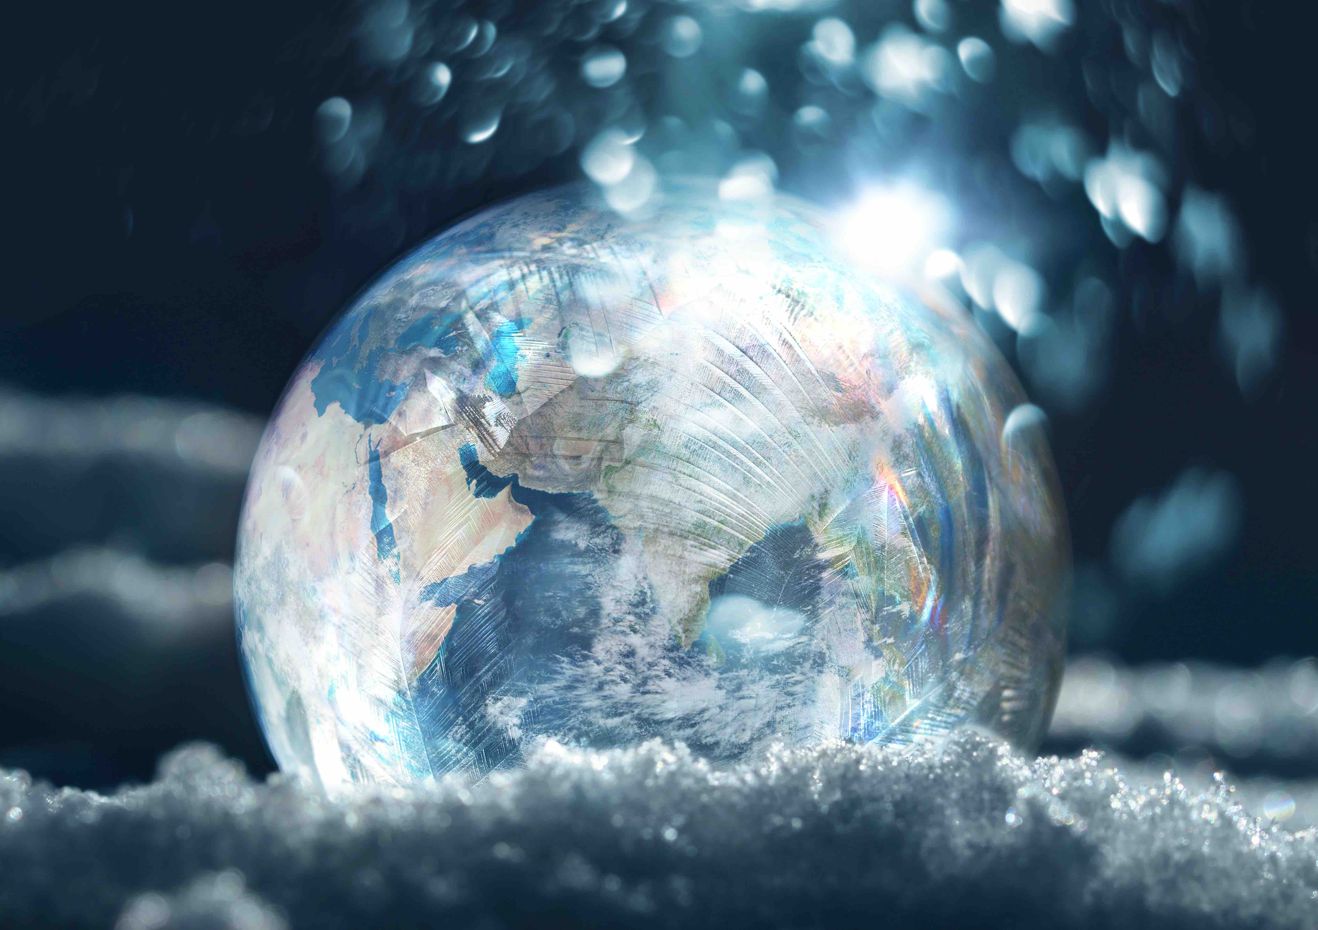
Snow and Climate Change

Slide 2
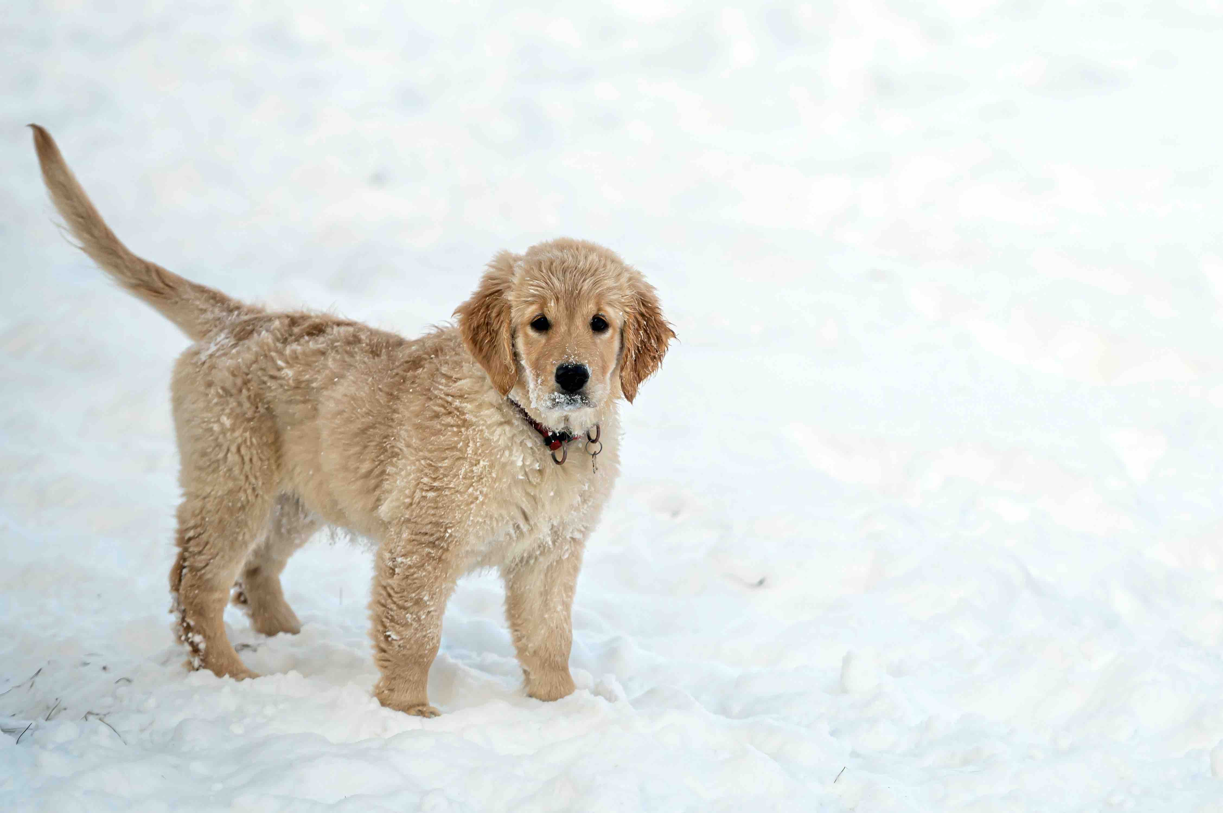
What do you love about snow?

Slide 3
What is snow?

Slide 4
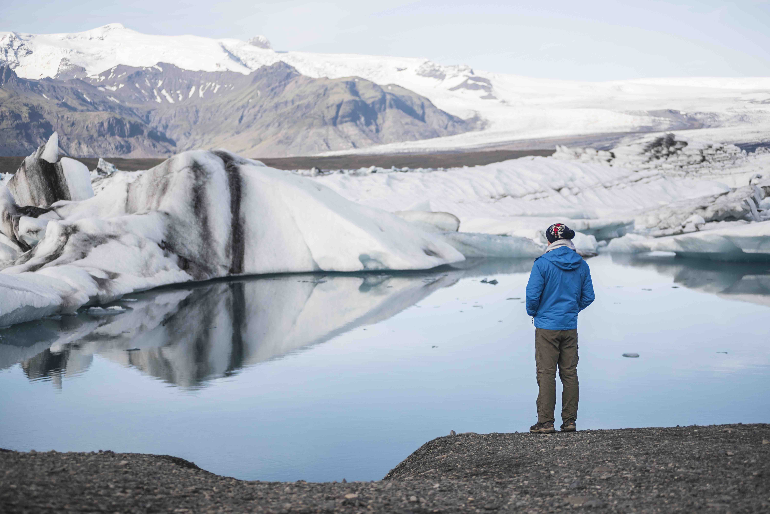
What does climate change
have to do with snow?

Slide 5
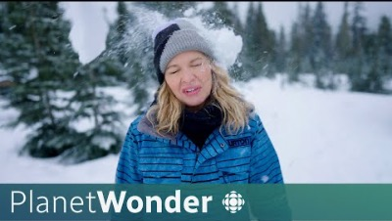
Watch and Reflect
Source: CBC News: What can snow teach us about climate change? | Planet Wonder
https://youtu.be/M6JBkx4Lyjk?si=i_G26I_IQixeFi9d
Notes:
YouTube video link:
https://youtu.be/M6JBkx4Lyjk?si=i_G26I_IQixeFi9d
Source: CBC News:
What can snow teach us about climate change? | Planet Wonder
https://youtu.be/M6JBkx4Lyjk?si=i_G26I_IQixeFi9d

Slide 6
Discussion
What did you learn from the video about how climate change is affecting snow in Canada?
How is the changing snowpack impacting people's lives and activities, as mentioned in the video?
Why do you think it's important to study and understand the impact of climate change on snow and the environment?
What are some ways individuals and communities can adapt to the changing snow conditions described in the video?
What actions can we take to reduce our impact on climate change and help preserve winter and snow in the future?

Slide 7
What can YOU do?
Notes:
Ask each group to brainstorm and list climate-friendly actions that individuals, schools, or communities can take to reduce their impact on climate change and protect snow and winter activities.
Encourage creativity and practicality in their ideas.
What can YOU do?

