Slide 1
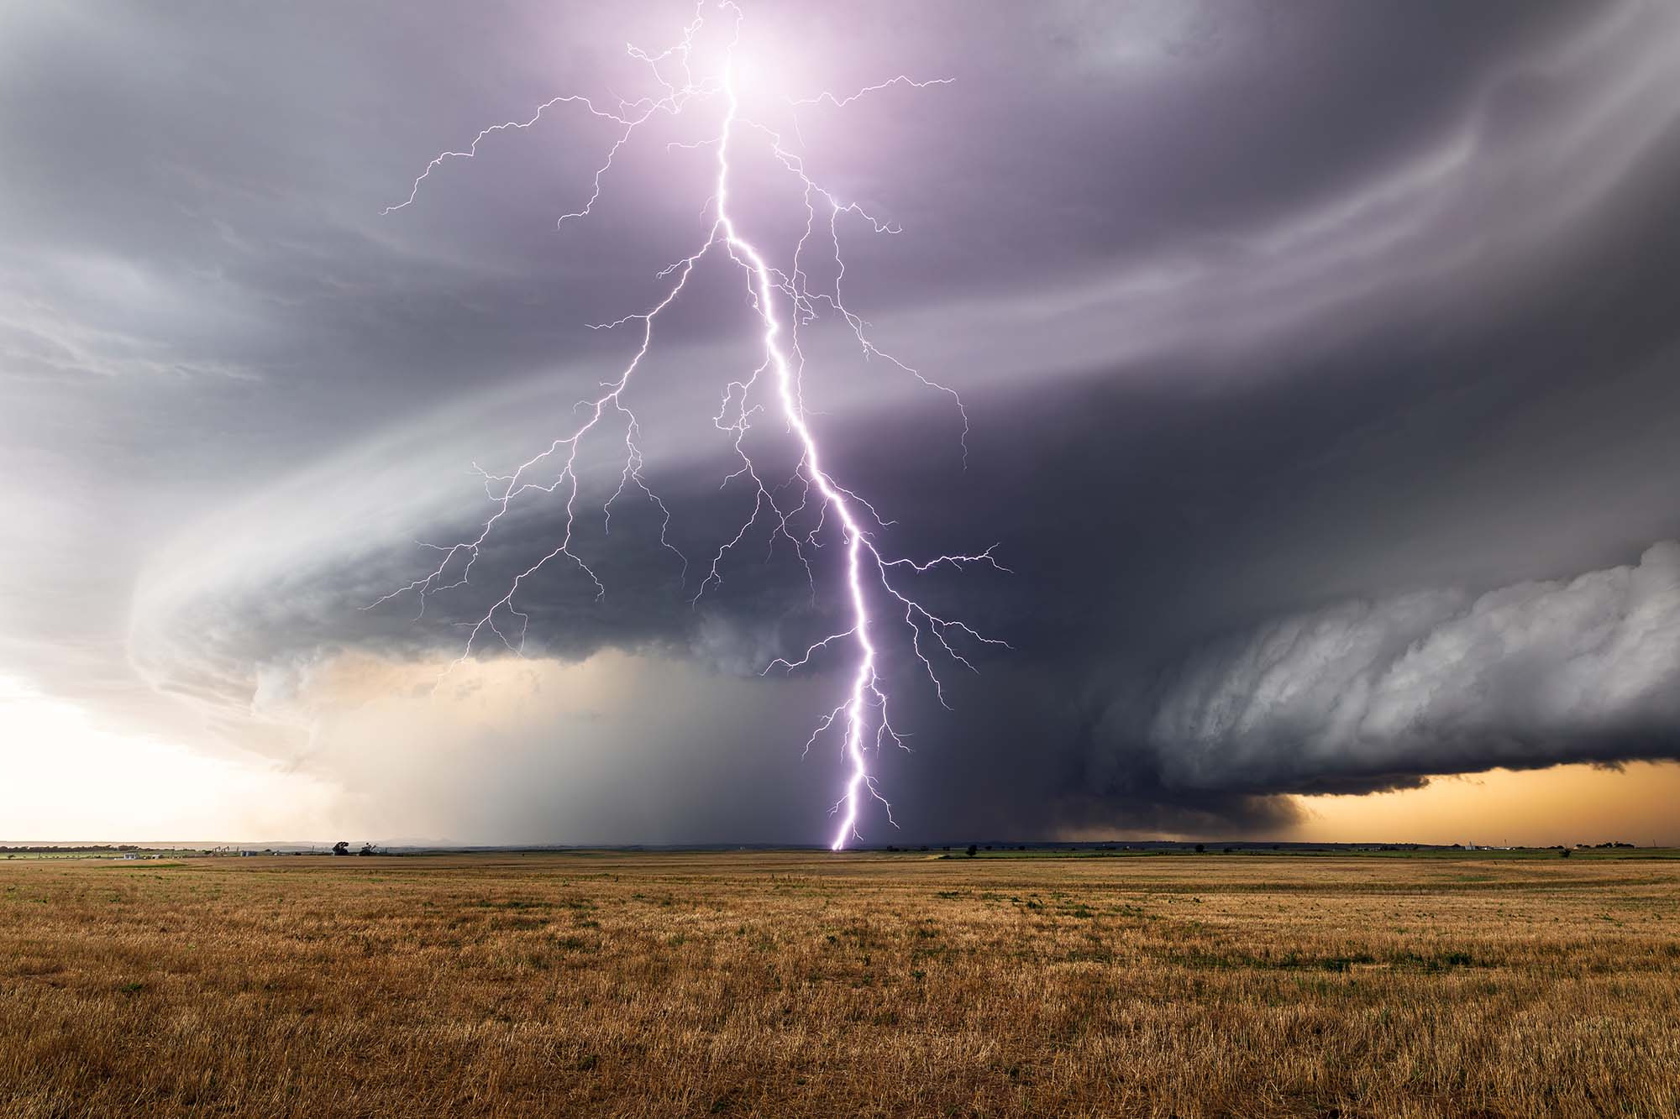
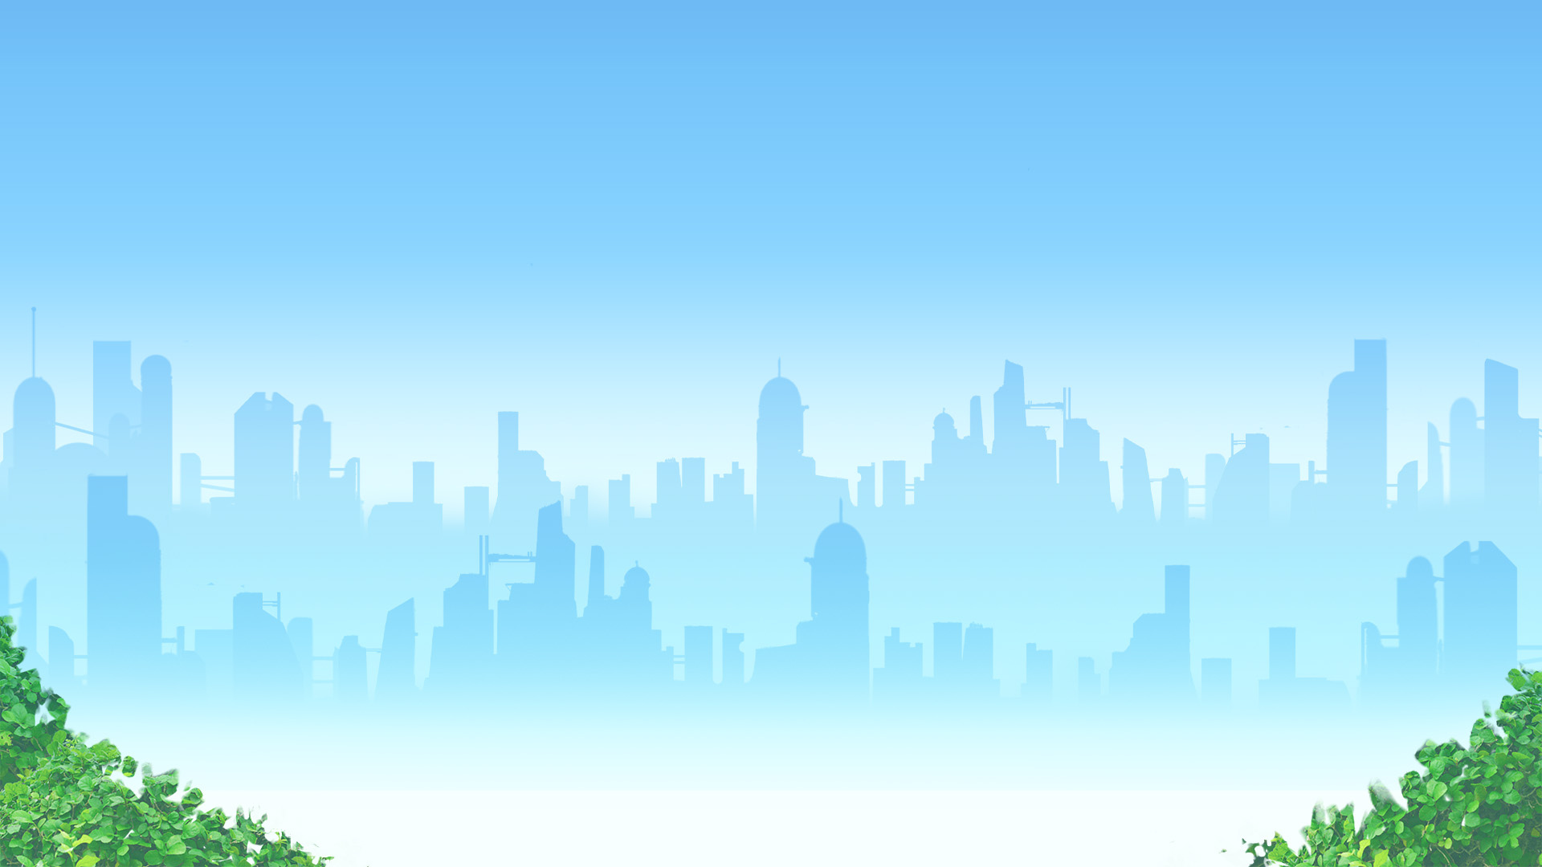


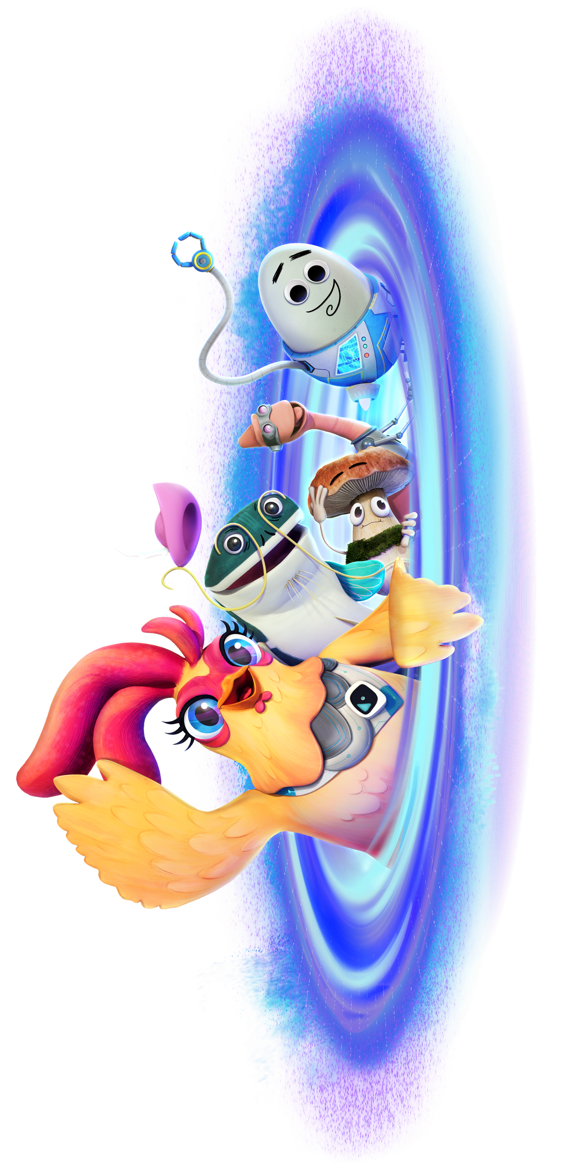
Global
Weirding
with Katharine Hayhoe
& Future Chicken
Learn More at
www.futurechicken.com

Slide 2
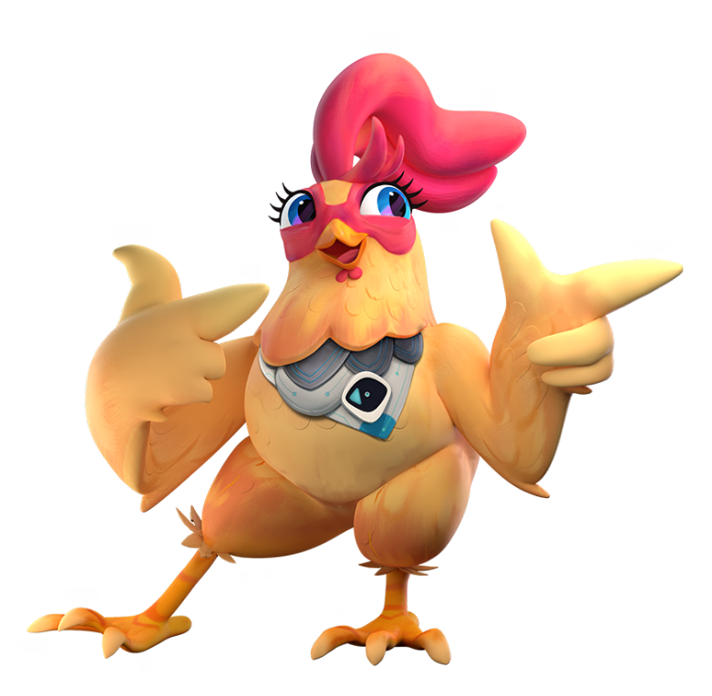
Viewing
Notes
This presentation is best viewed in SLIDESHOW MODE so you can reveal discussion topics and answers at your own pace.
To find Editable Assessment Checklists, cluck…I mean click here:
Global Weirding Assessment Checklists

Slide 3
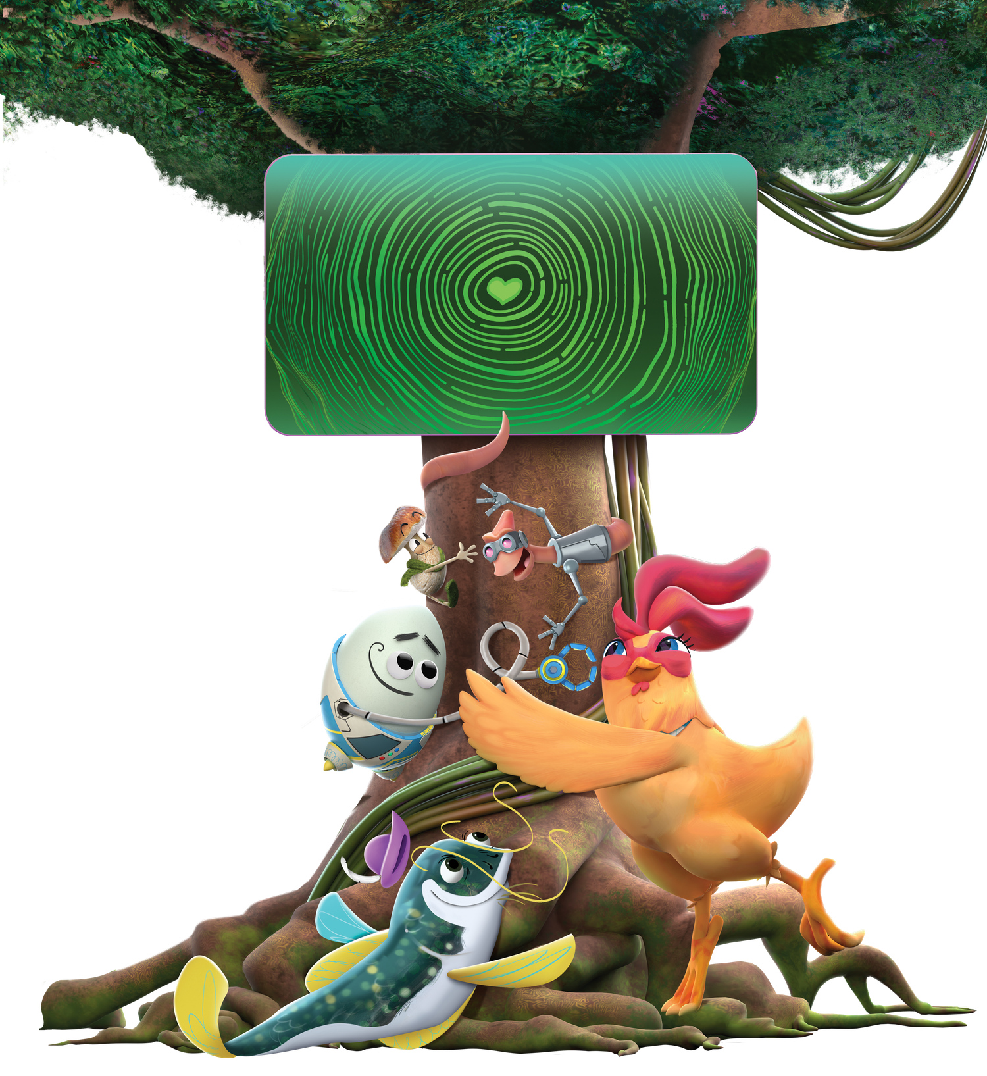
Learning
Goals
  Understand the connection between people, animals, plants, and the Earth
  Learn about weather, climate, and the atmosphere
  Explore how human actions affect the environment
  Build empathy for living things and the planet we share
  Practice observation, questioning, and critical thinking skills
  Discover small everyday actions that can help protect the Earth

Slide 4
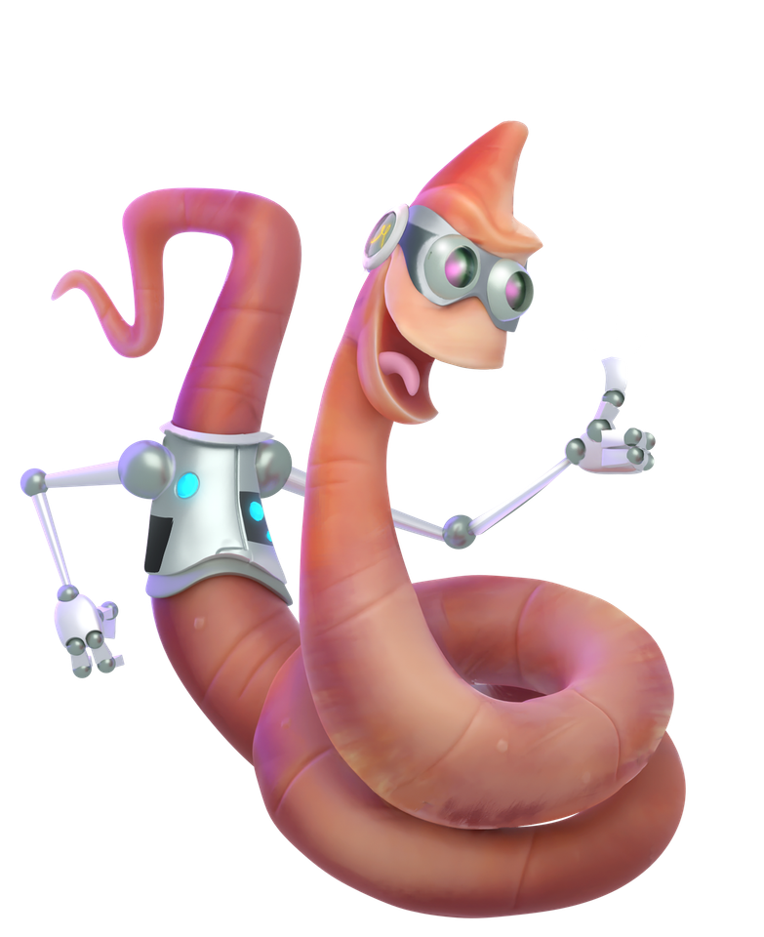
What kinds of weather can you name?
Pre-video
What does the word “weird” mean to you?
Questions
What do you think “weird weather” means?
Five questions to think and/or talk about before you watch the video.
Click next to see each question.
Have you ever experienced unusual or unexpected weather?
What do you think an atmospheric scientist studies?

Slide 5
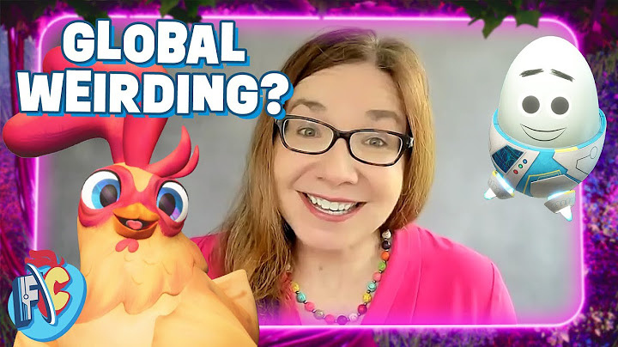

Science for Kids | Global Weirding not Global Warming with Dr. Katharine Hayhoe
Watch
the Video
Special guest Katharine Hayhoe, a renowned climate scientist, joins the team to explain the concept of Global Weirding and how every action we take can make a difference. She shares insights on how kids and communities can work together to combat climate change and become catalysts for inventive change.
https://www.youtube.com/watch?v=_XXySb9D7V8
| 11 minutes

Slide 6
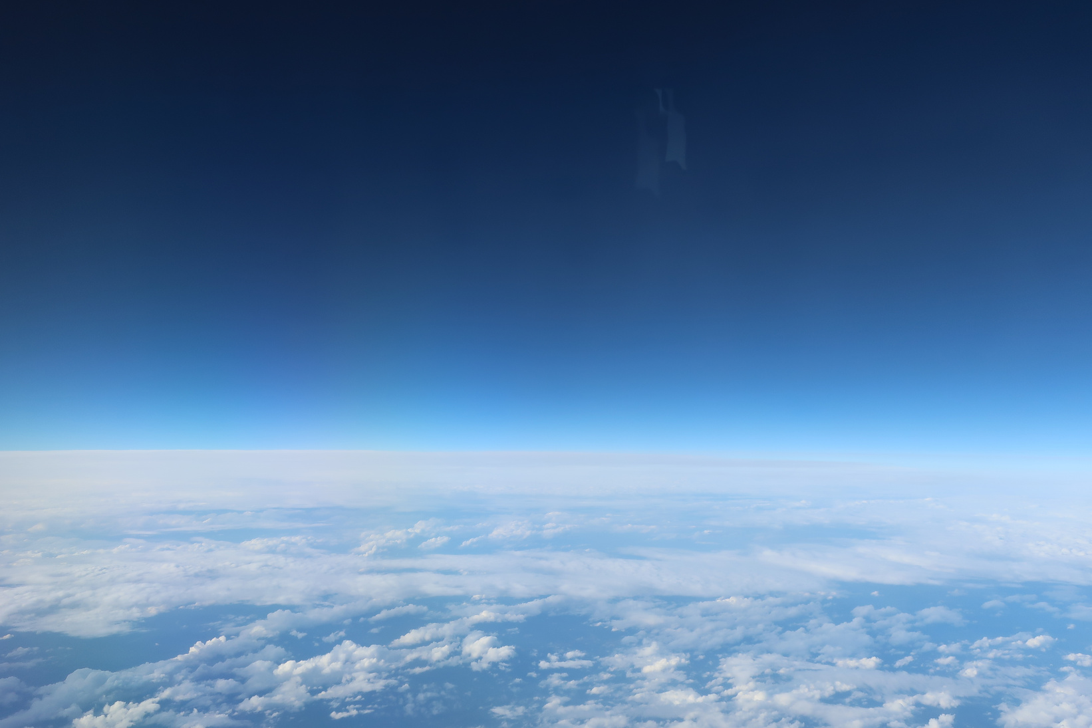
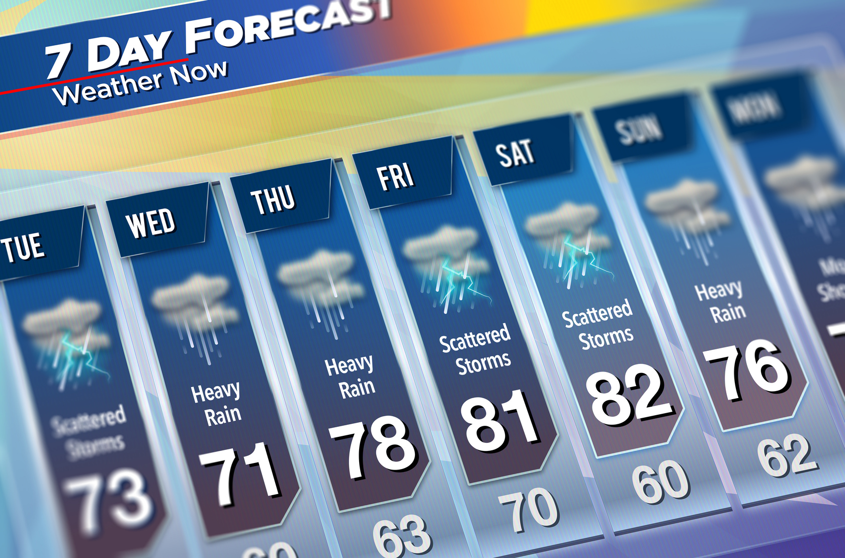

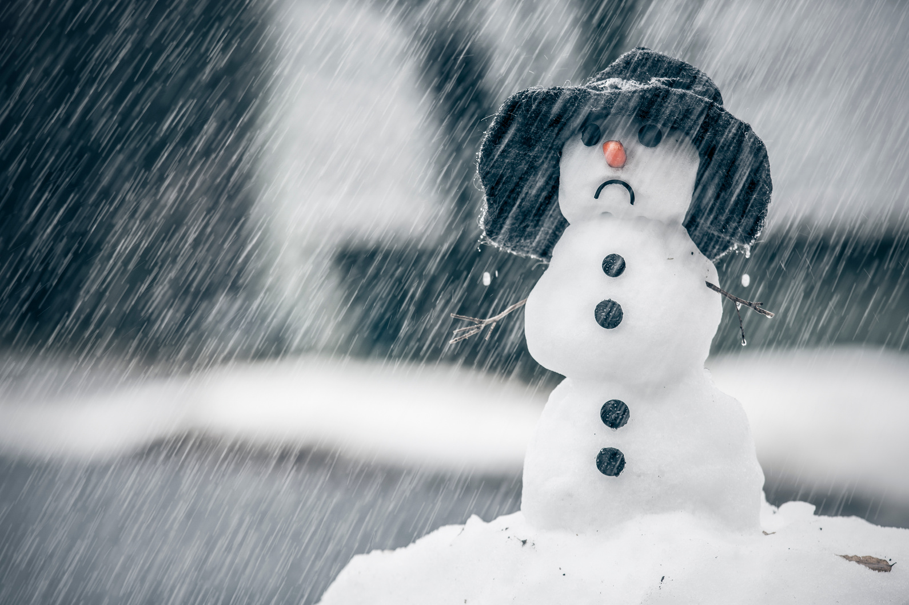
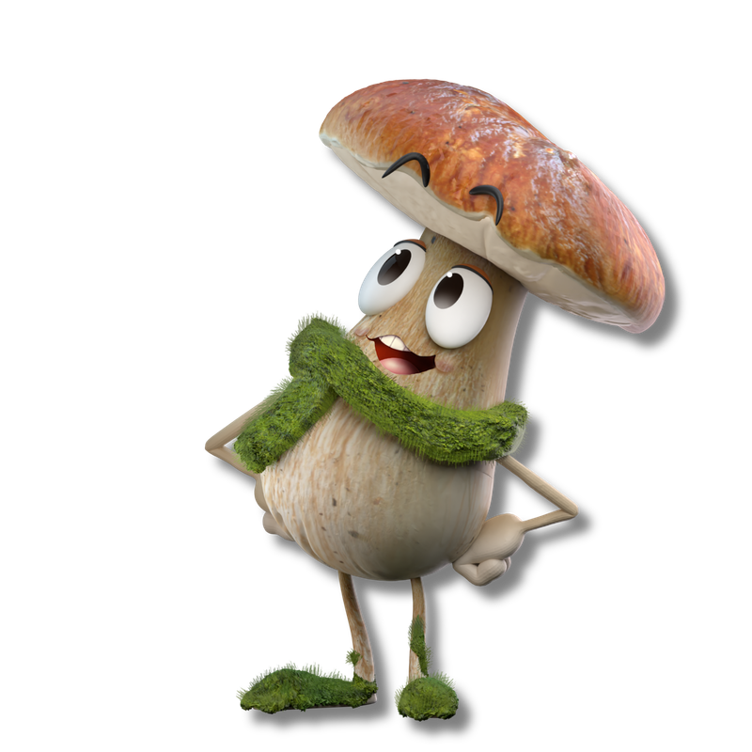
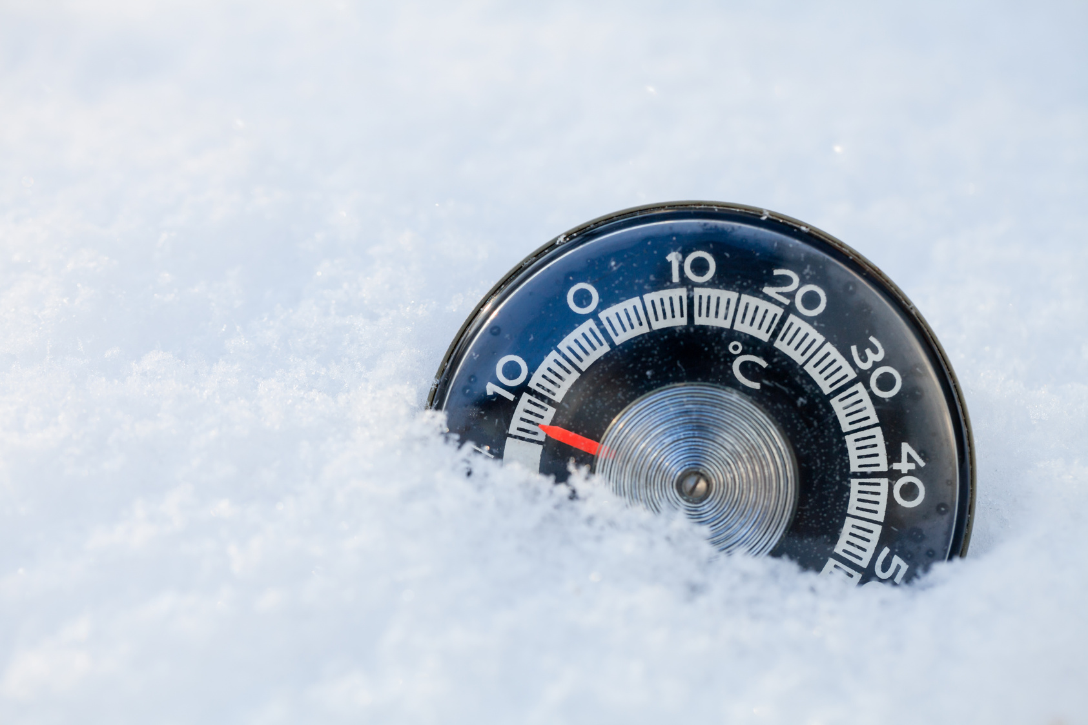
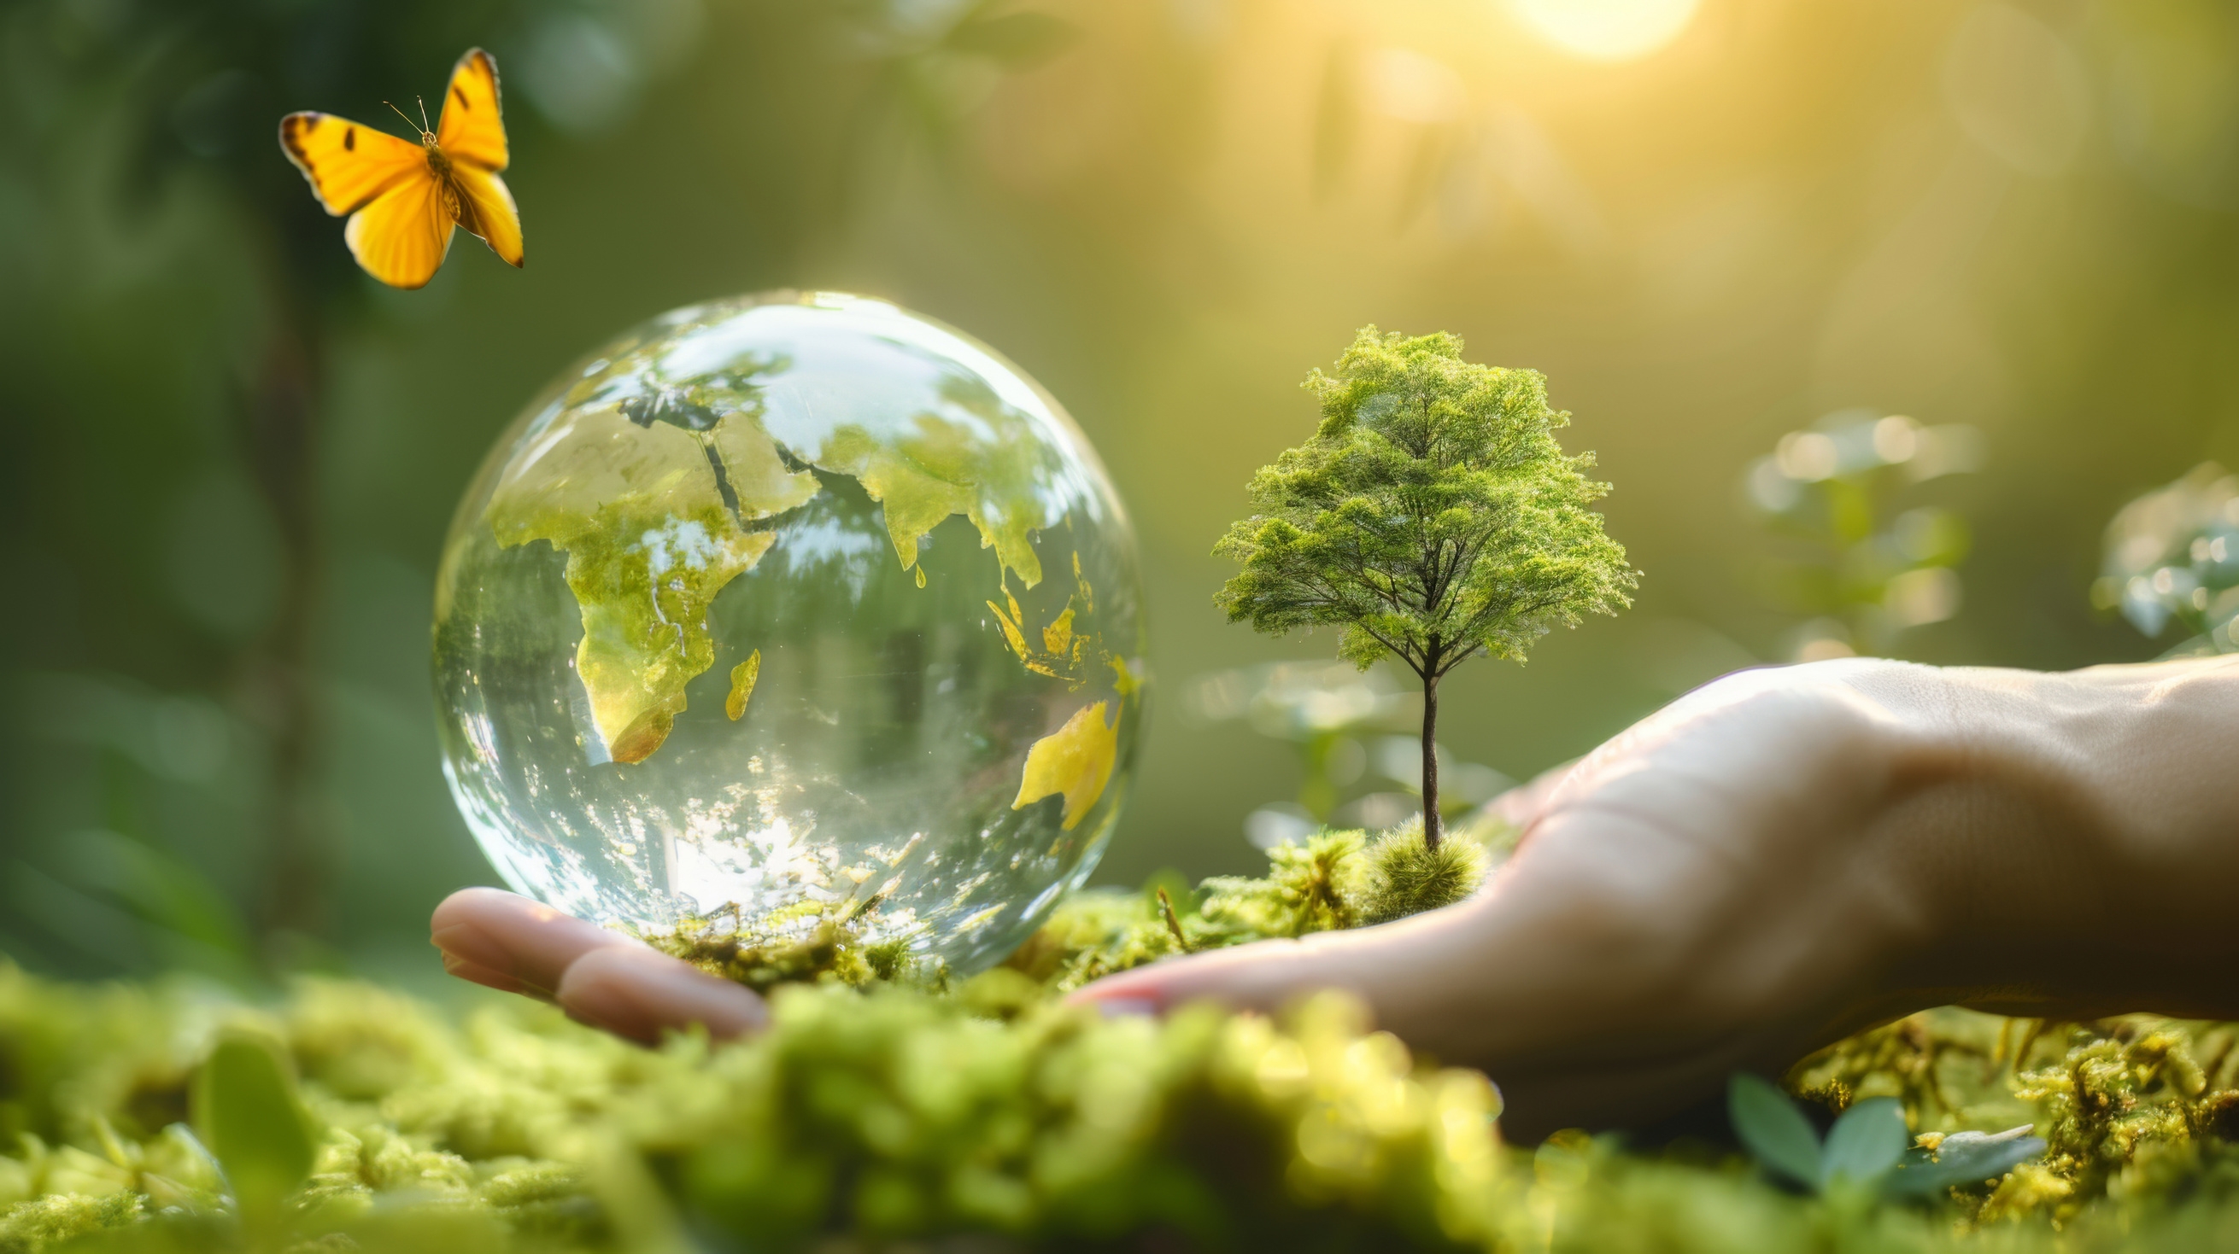
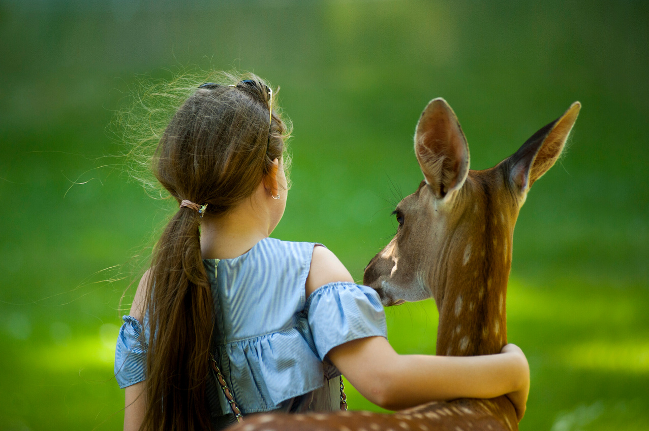
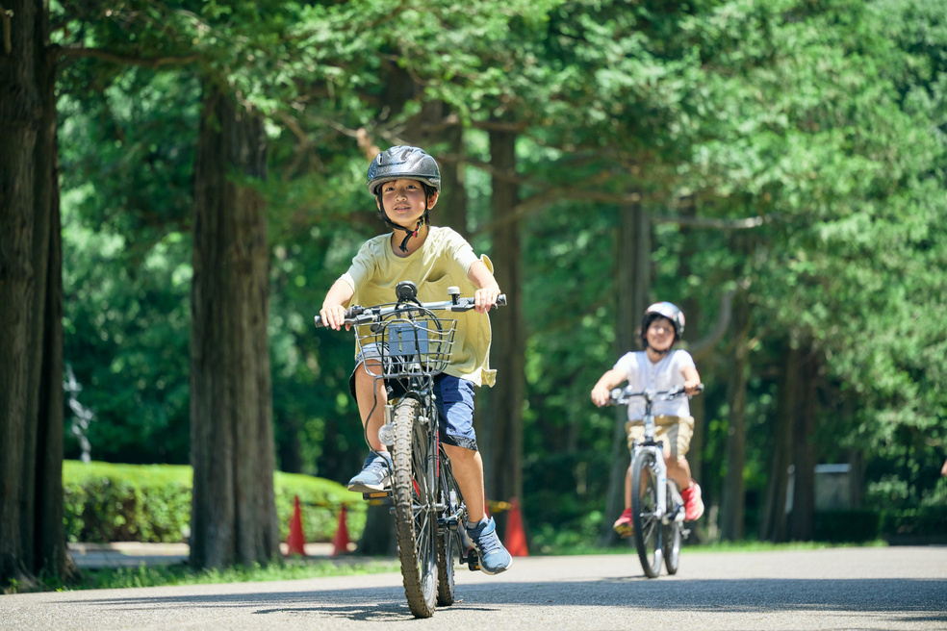
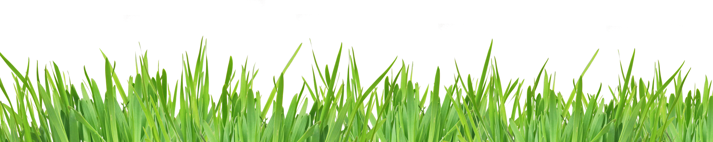
Post-video
Questions
What is the atmosphere, and why is it important?
Why do scientists study and monitor weather patterns?
Why does Dr. Hayhoe describe the weather as “changeable”?
What does “global weirding” mean?
How do human actions contribute to changes in weather patterns?
What resources do humans and animals share?
What small actions can we take to help the planet and each other?
What does it mean to share the Earth?

Slide 7
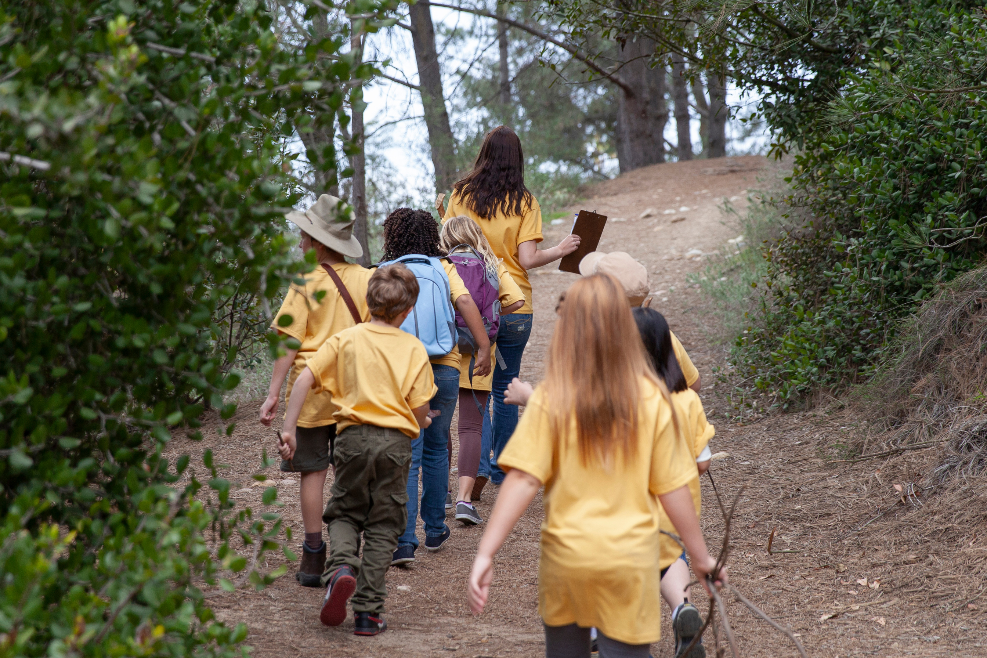
Wonder Wall
Step 1: Outdoor Activity
Materials Needed:
  A digital camera, tablet, or smartphone for taking photos
  OR clipboards, paper, crayons, or markers for drawing observations
Activity Instructions
Take children on a short outdoor nature walk around the schoolyard, neighbourhood, park, or playground.
Ask children:
  What do you notice?
  What do you wonder about?
  What living things can you find?
Children can document their observations by taking photos or drawing what they see.

Slide 8
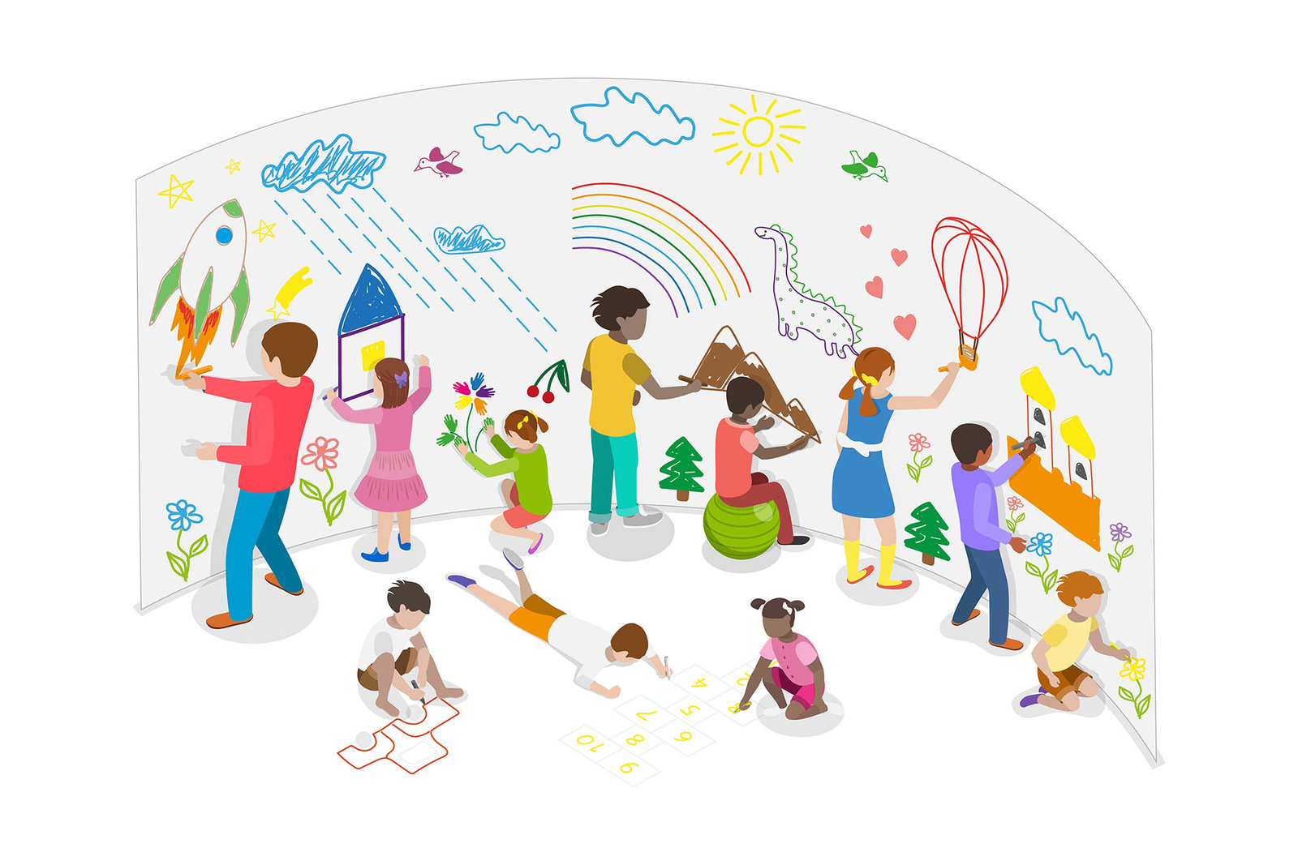
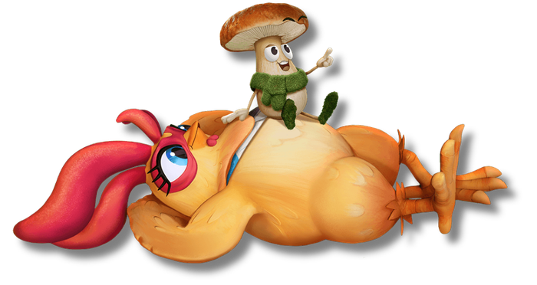
Wonder Wall
Step 2: In-classroom
After the walk:
Create a classroom or home “Wonder Wall” where children can post:
  Questions about nature and the environment
  Drawings or photos of plants, insects, trees, weather, or animals
  Observations about human impact on the environment
Example Wonder Wall Questions:
Y ounger children may ask:
  Where do puddles go?
  Why do leaves change colour?
  Which tree is my favourite and why?
Older children may ask:
  Why does litter collect in certain places?
  How do humans affect local ecosystems?
  Why are weather patterns changing?

Slide 9
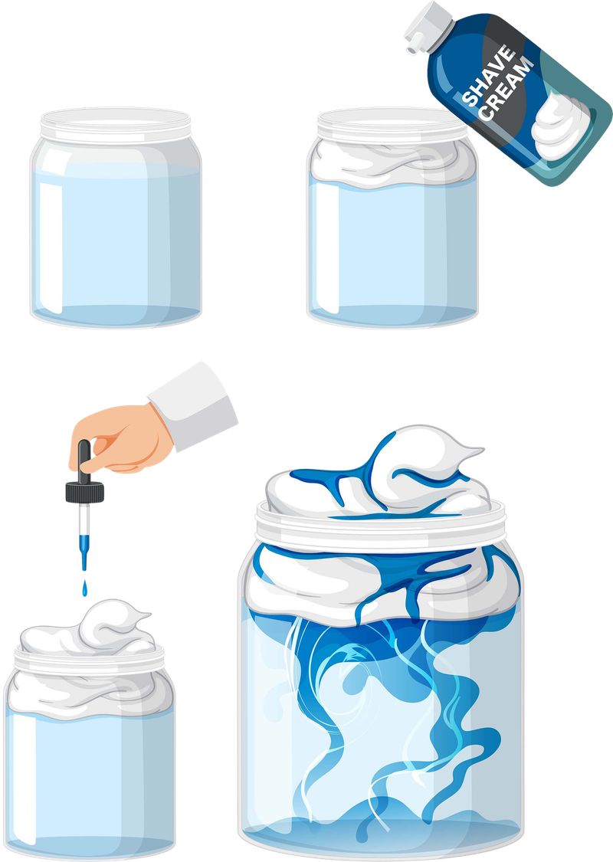
Experiment with adding more or less food colouring to compare light rain and heavy rain.
Encourage children to make predictions before testing the experiment.
Connect the activity back to the video discussion about “global weirding” and changing weather patterns.
Make Rain in a Jar
Hands-On Weather Experiment
Materials Needed:
  A clear glass jar or transparent cup
  Warm water
  Shaving cream
  Blue food colouring or watered-down blue paint
  A dropper, pipette, or spoon
Activity Instructions
  Fill the jar about three-quarters full with warm water. This represents the air in the atmosphere.
  Add a layer of shaving cream on top of the water to create a “cloud.”
  Slowly drip blue food colouring onto the shaving cream cloud.
  Watch as the colour begins to move through the shaving cream and fall into the water like rain.
As the cloud becomes heavier and more saturated, the “rain” falls through—just like real rain clouds in the atmosphere.

Slide 10
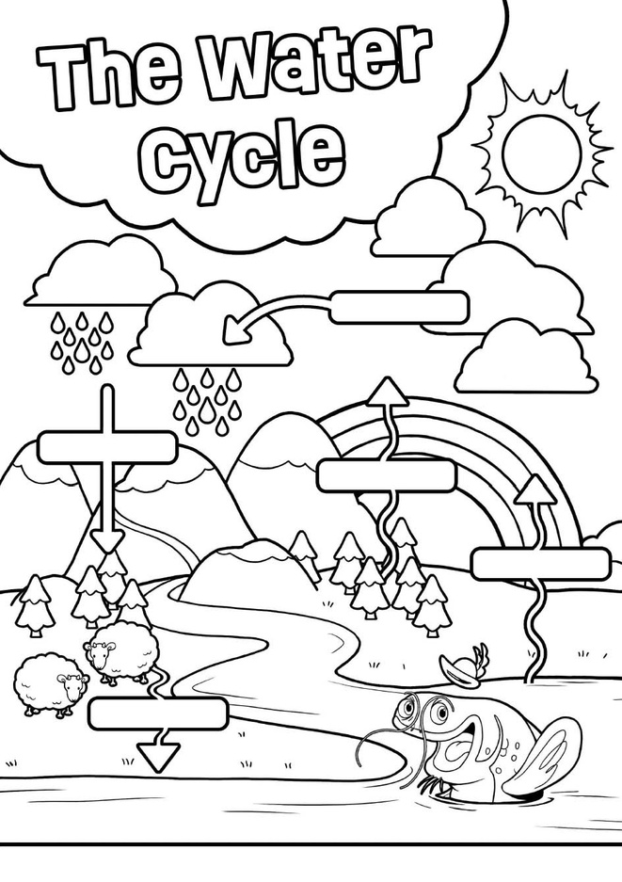
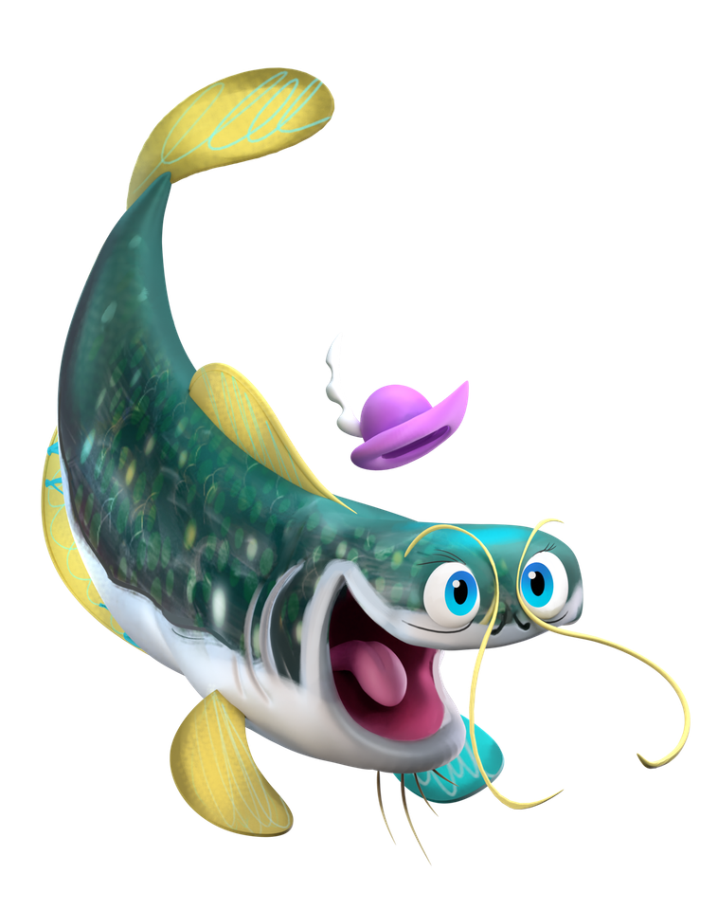
Make Rain in a Jar
Questions to Explore Together
Try this: can you colour and label the water cycle?
What happened when the cloud became too full?
How is this similar to real rain clouds?
How do clouds produce rain?
Have you ever seen (or been in) a heavy rainstorm or snowstorm? What did you see or hear? How did it feel?
How might changing weather patterns affect people, animals, and plants?
Download the activity sheet at:
https://futurechicken.com/learning-resources/colouring-page-the-water-cycle/

