Slide 1

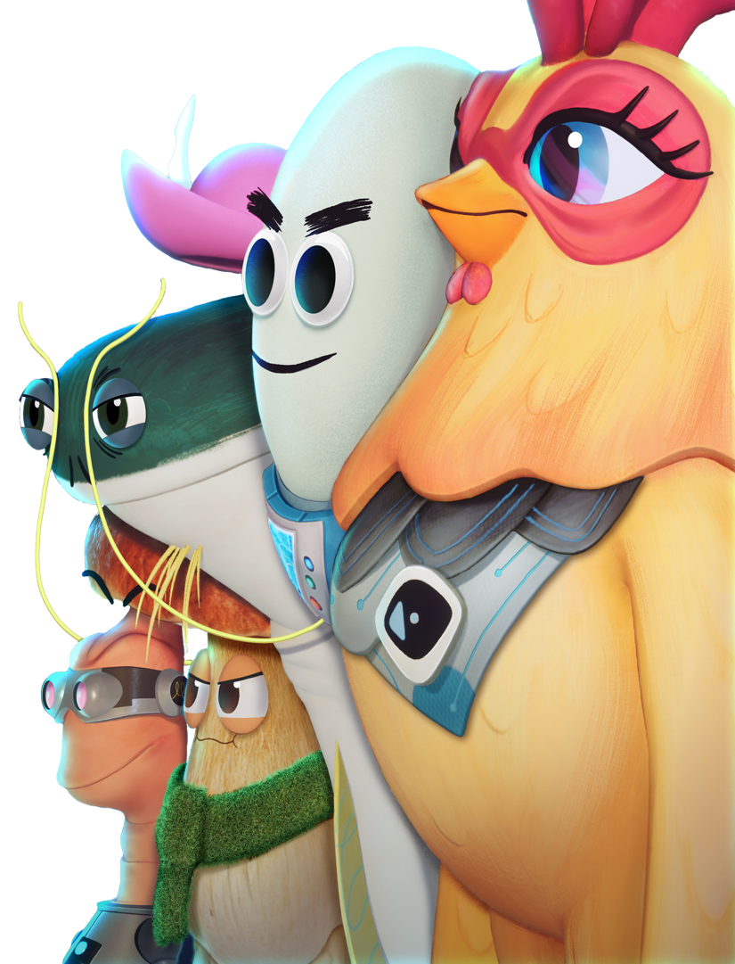

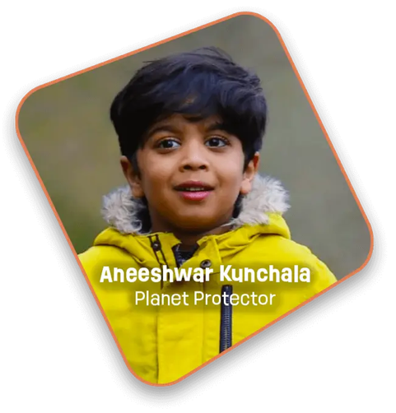
Animal
Superpowers
with Aneeshwar Kunchala
& Future Chicken
Learn More at
www.futurechicken.com

Slide 2
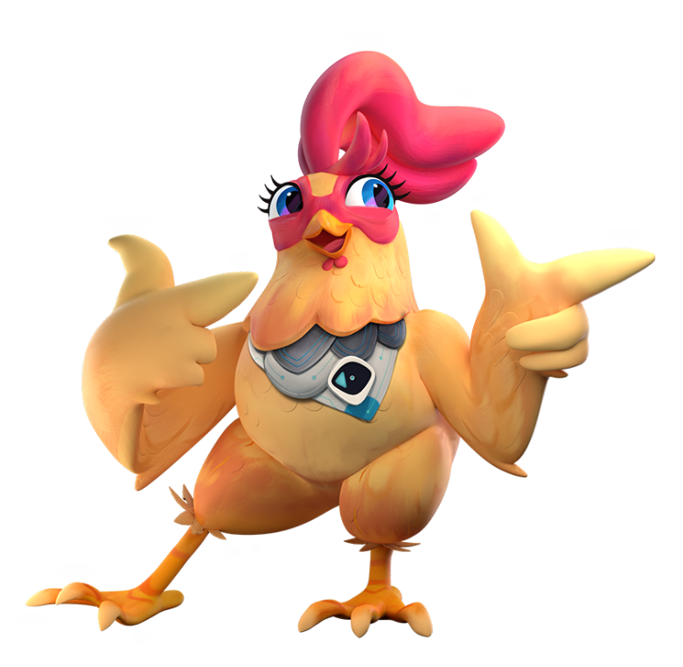
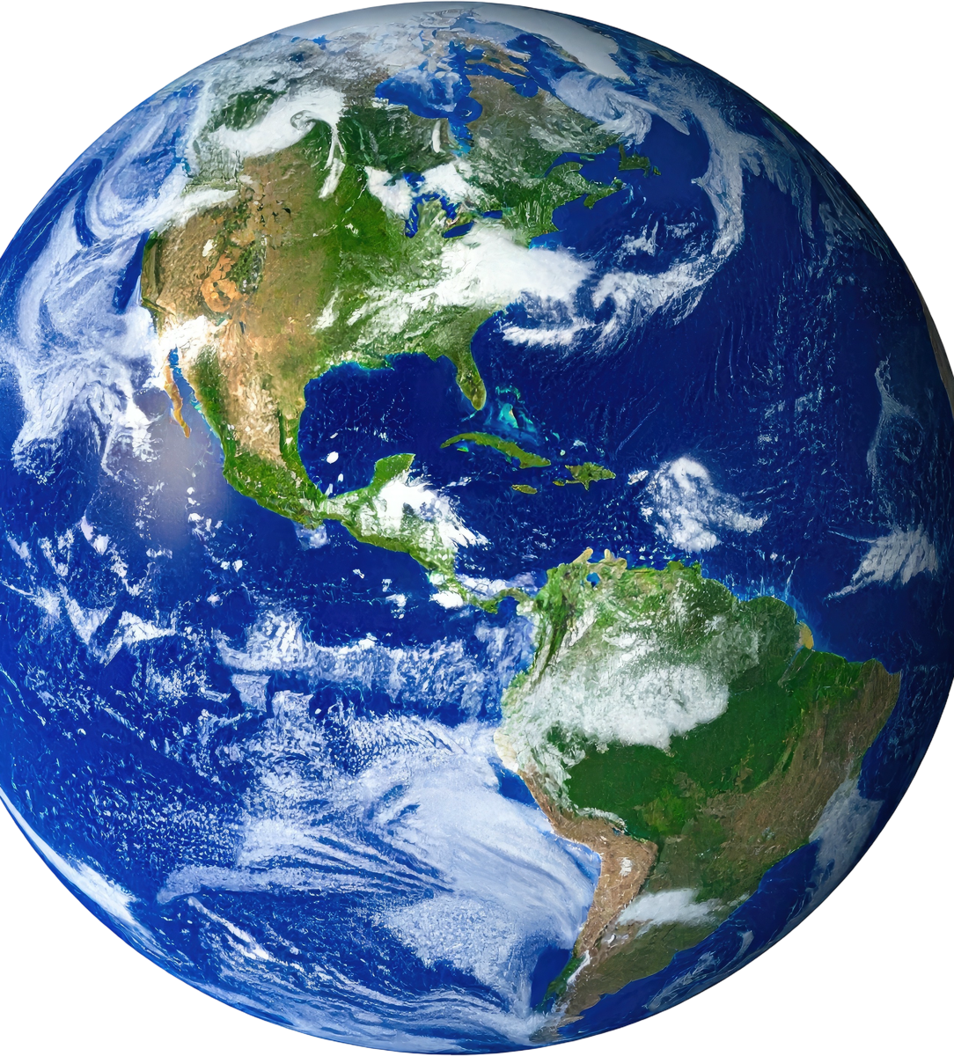
Viewing
Notes
This presentation is best viewed in SLIDESHOW MODE so you can reveal discussion topics and answers at your own pace.
To download the Editable Assessment Checklists, cluck…I mean click here:
Assessment Checklists

Slide 3

Learning
Goals
  Identify and demonstrate grade-appropriate oral communication skills in large- and small-group discussions
  Identify the basic needs of animals
  Identify animals as either domestic or wild
  Identify actions we can take to protect local habitats (so that wild animals can meet their needs)
  Describe some “superpowers”/adaptations that help animals survive in their habitats
  Explore self concept: Identify “superpowers” in others and yourself.

Slide 4
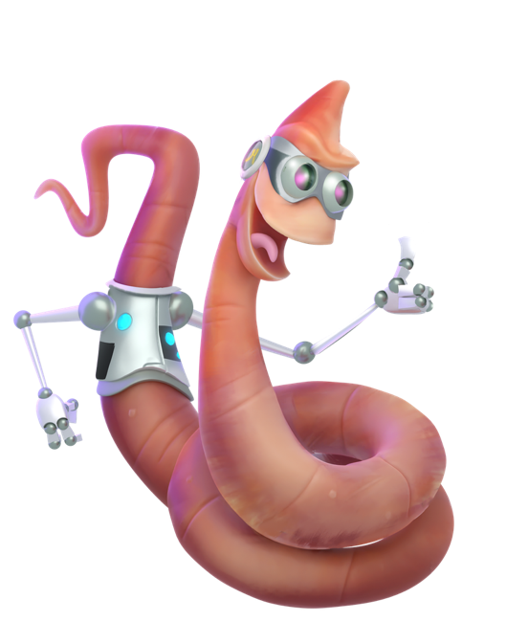
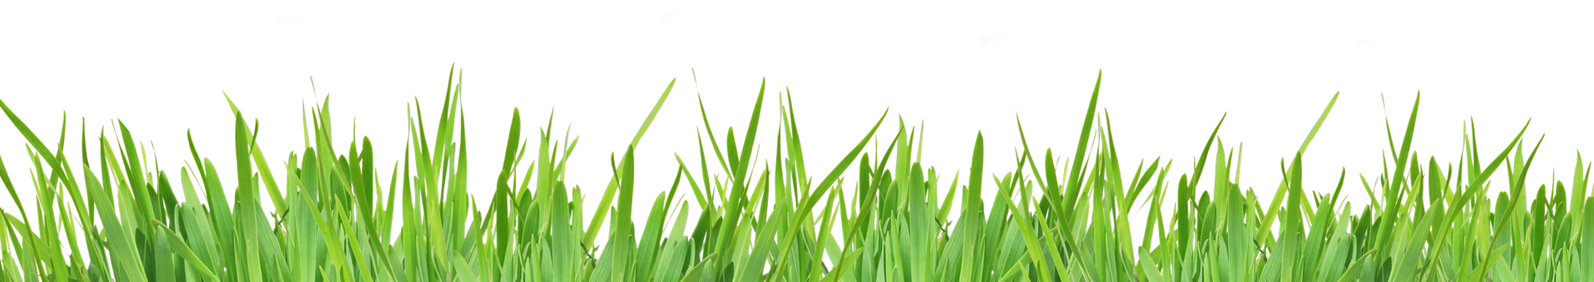
Topic | Slide #
Previewing Questions: Animal Superpowers | 5
Post-Viewing Questions: Examples of Connecting With and Protecting Animals, and Identifying Effective Speaking Skills | 6, 7
Domestic vs Wild Animals | 9, 10
Basic Needs of ALL Animals | 11
Needs of Wild Animals and How Habitats Meet their Needs | 11 - 14
How Animals’ Superpowers Help Them Survive in their Habitats | 15 - 17
Ways to Connect with and Protect Animals & their Habitats | 18 - 22
What is Your Superpower? | 23
Links to Free, Effective, Ready-to-use Animal Adaptations Activities | 24
Links to Future Chicken Shorts: Animal Adaptations; Habitats; Connect & Protect | 25
Slideshow
Overview

Slide 5
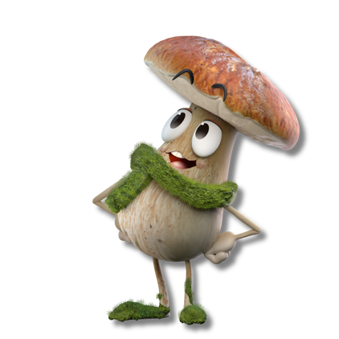
Think about your favourite animal. What do you love about it?
Pre-video
Questions
In the video, you’ll meet Aneeshwar. He says that animals and people have superpowers. What do you think he might mean by that?
Three questions to think and/or talk about before you watch the video.
Click next to see each question.
What do you think a chicken’s superpowers might be?

Slide 6
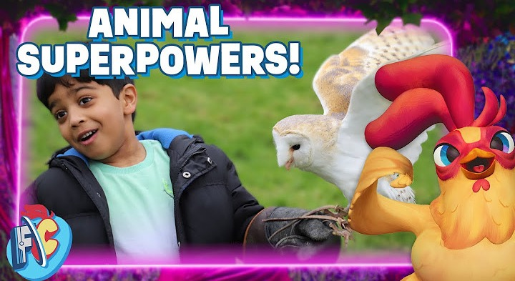

Animal Facts and Superpowers for Kids
With Aneeshwar Kunchala
Watch
the Video
Joined by special guest Aneeshwar Kunchala, a passionate wildlife conservationist, Future Chicken and Frittata discover the incredible superpowers of various animals and how we can all be heroes by observing, connecting, and protecting wildlife. Aneeshwar shares his inspiring journey and teaches us that every creature, big or small, has unique strengths.
https://www.youtube.com/watch?v=j-36H6G_wDg&t=1s
| 11 minutes

Slide 7
Post-video
Questions
CONNECT
and...
PROTECT
What are some ways that Aneeshwar
connects with animals and nature?
What are some ways that Aneeshwar
protects animals and nature?
How does Future Chicken connect with an inchworm in the video?
How does Future Chicken protect
animals and nature?
Talk, write or draw about a time when you
have felt connected with an animal or nature.
What are some ways you have
protected animals and nature?

Slide 8
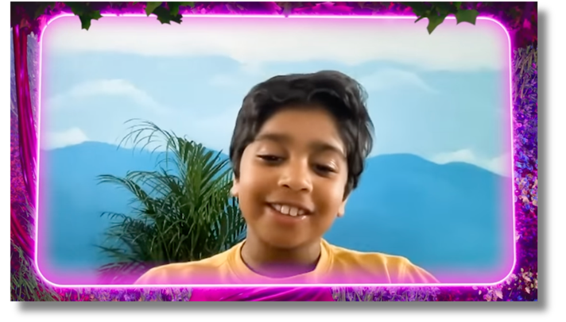
More Post-Video
Questions
THINK ABOUT:
word choice
voice
pace
face
What makes Aneeshwar an engaging speaker?
gestures
staying on topic
other things?

Slide 9
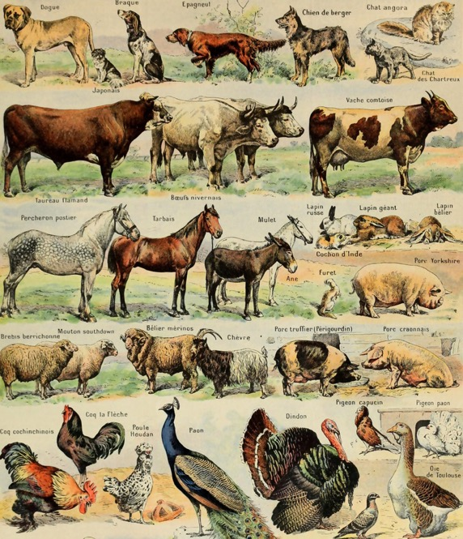
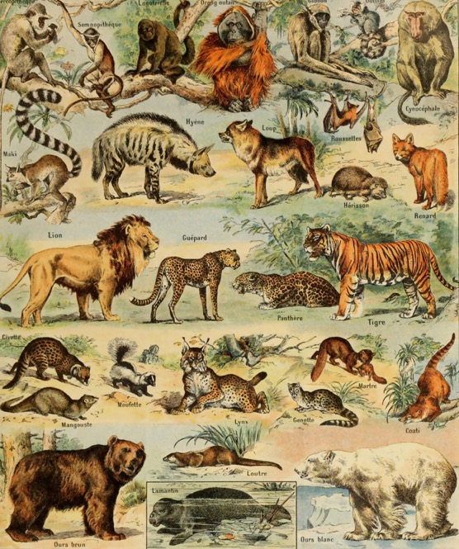
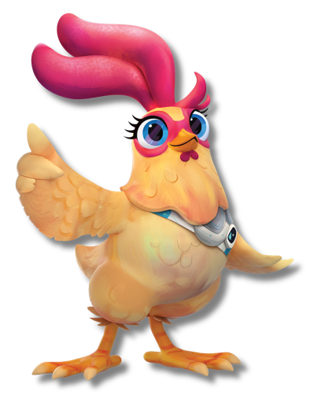
DOMESTIC animals
WILD animals
Which group do I belong to?

Slide 10

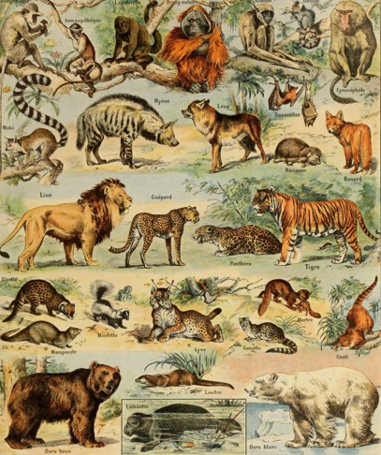
DOMESTIC animals
WILD animals
Finish these sentences:
Domestic animals live
Wild animals live

Slide 11
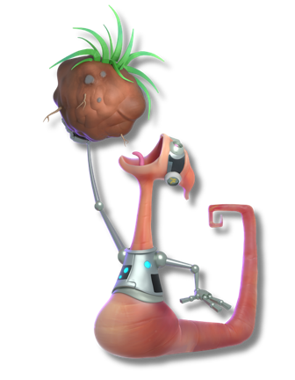
DOMESTIC animals
WILD animals
Name 4 things
ALL animals need to survive
Food
Shelter
Water
Space

Slide 12
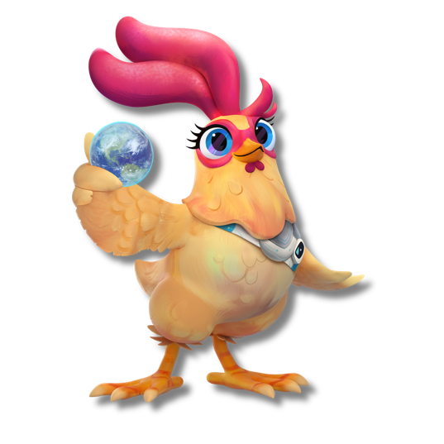
DOMESTIC animals
WILD animals
How do humans make sure that domestic animals have everything they need?
How can we make sure that animals in the WILD have everything they need?

Slide 13
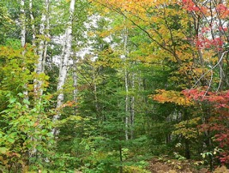
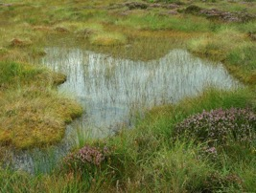
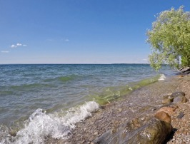
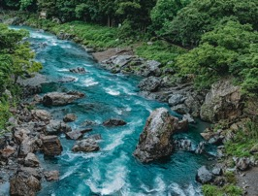

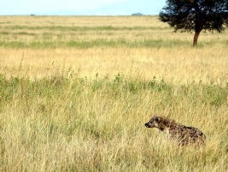
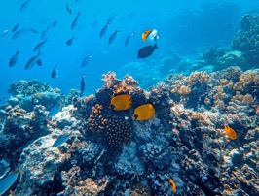
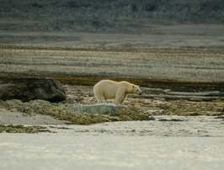
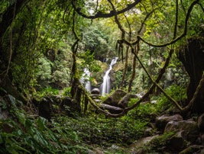
Can you name these habitats?
We can help wild animals meet their needs by protecting their habitats.
Forest
Wetland
Lake
River
Grassland
Coral Reef
Tundra
Rainforest

Slide 14
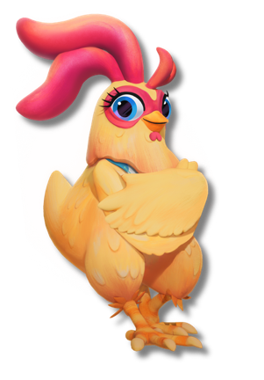
Can you name some animals that live in these habitats?
Forest
Wetland
Lake
River
Grassland
Coral Reef
Tundra
Rainforest
What can they eat?
How can they find water?
How can they stay safe?

Slide 15
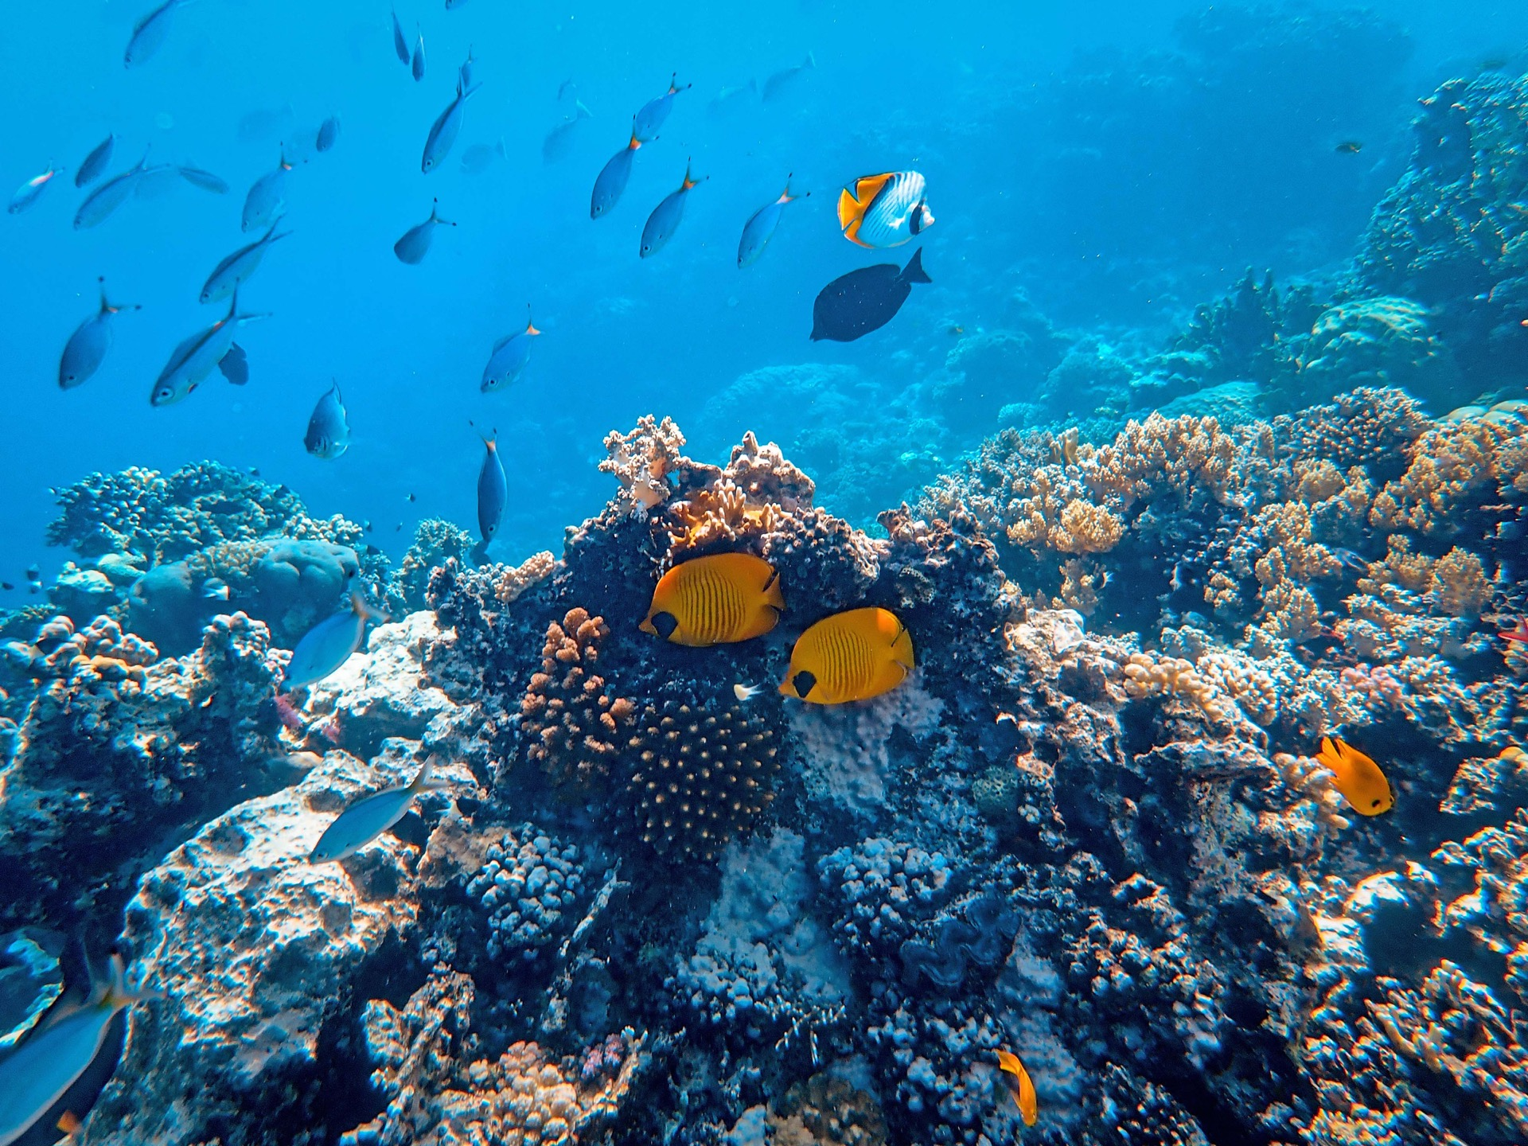
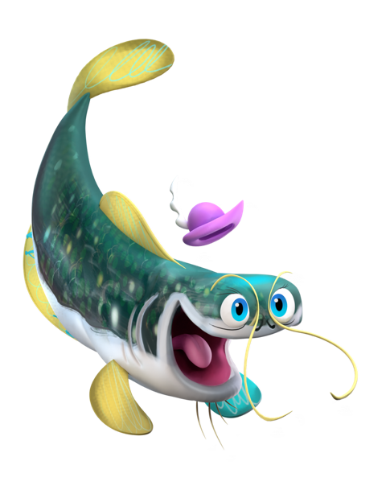
Could you live in this habitat?
If you wanted to live here, what superpowers would you need?

Slide 16
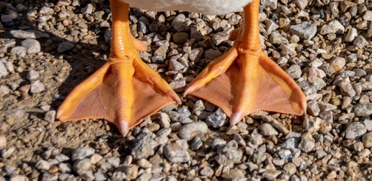
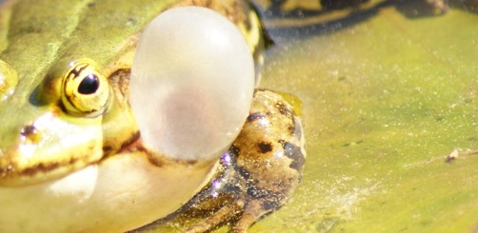
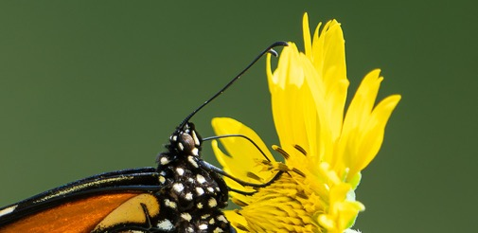
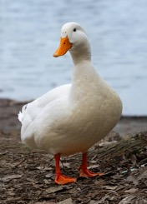
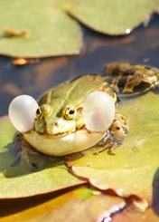
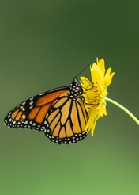
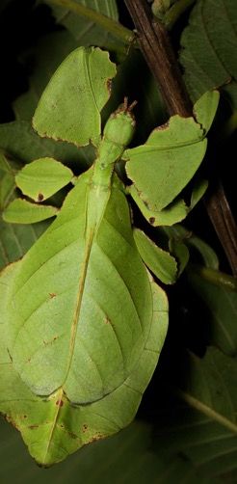
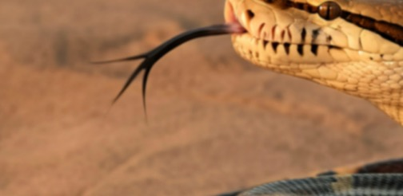
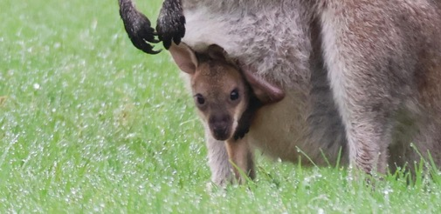
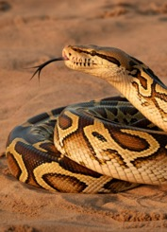
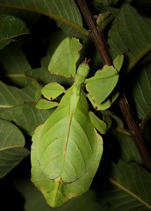
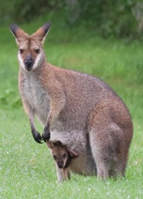
Can you identify these animals and their superpowers?
A butterfly’s long tubelike proboscis makes it a super sipper.
Butterfly antennae are super sniffers and super feelers.
Webbed feet
help ducks to be
super swimmers.
Vocal sacs make frogs super singers and super communicators.
Each fork on the snake’s tongue collects different scents from the air.
That makes it a super
prey-finder.
This kangaroo mom’s pouch makes her a super protector. Her huge feet and strong hind legs make her a super jumper.
This Giant Malaysian Leaf Insect’s leaflike body parts make it a super camouflager.

Slide 17
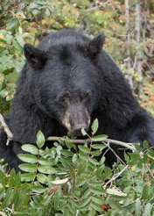
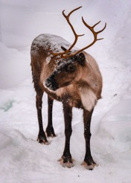
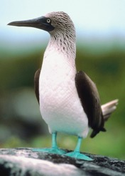
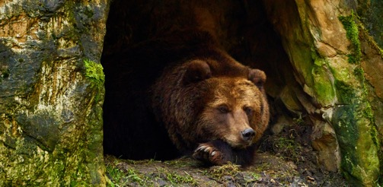
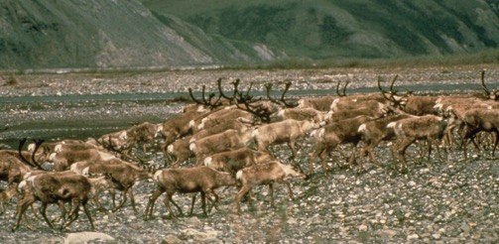
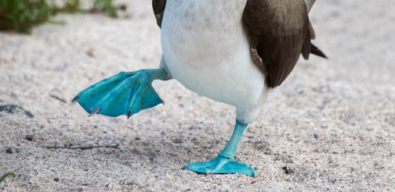
Some animals have superpowers that are actions or behaviours:
What superpower does this bear use to survive winter?
What superpower do caribou use when they can’t find lichen to eat?
What does this bird do when he wants to find a partner to start a family with?
Migration
Dance!
Hibernation

Slide 18
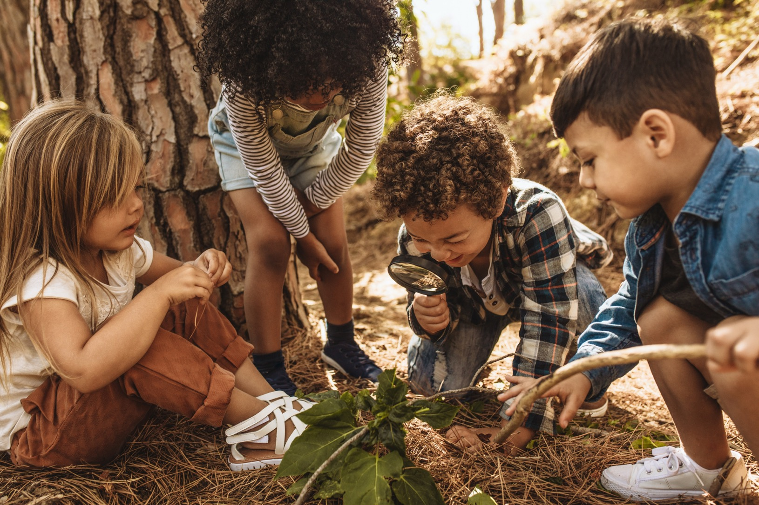

Explore local habitats.
What animals live in them?
What are their superpowers?

Slide 19
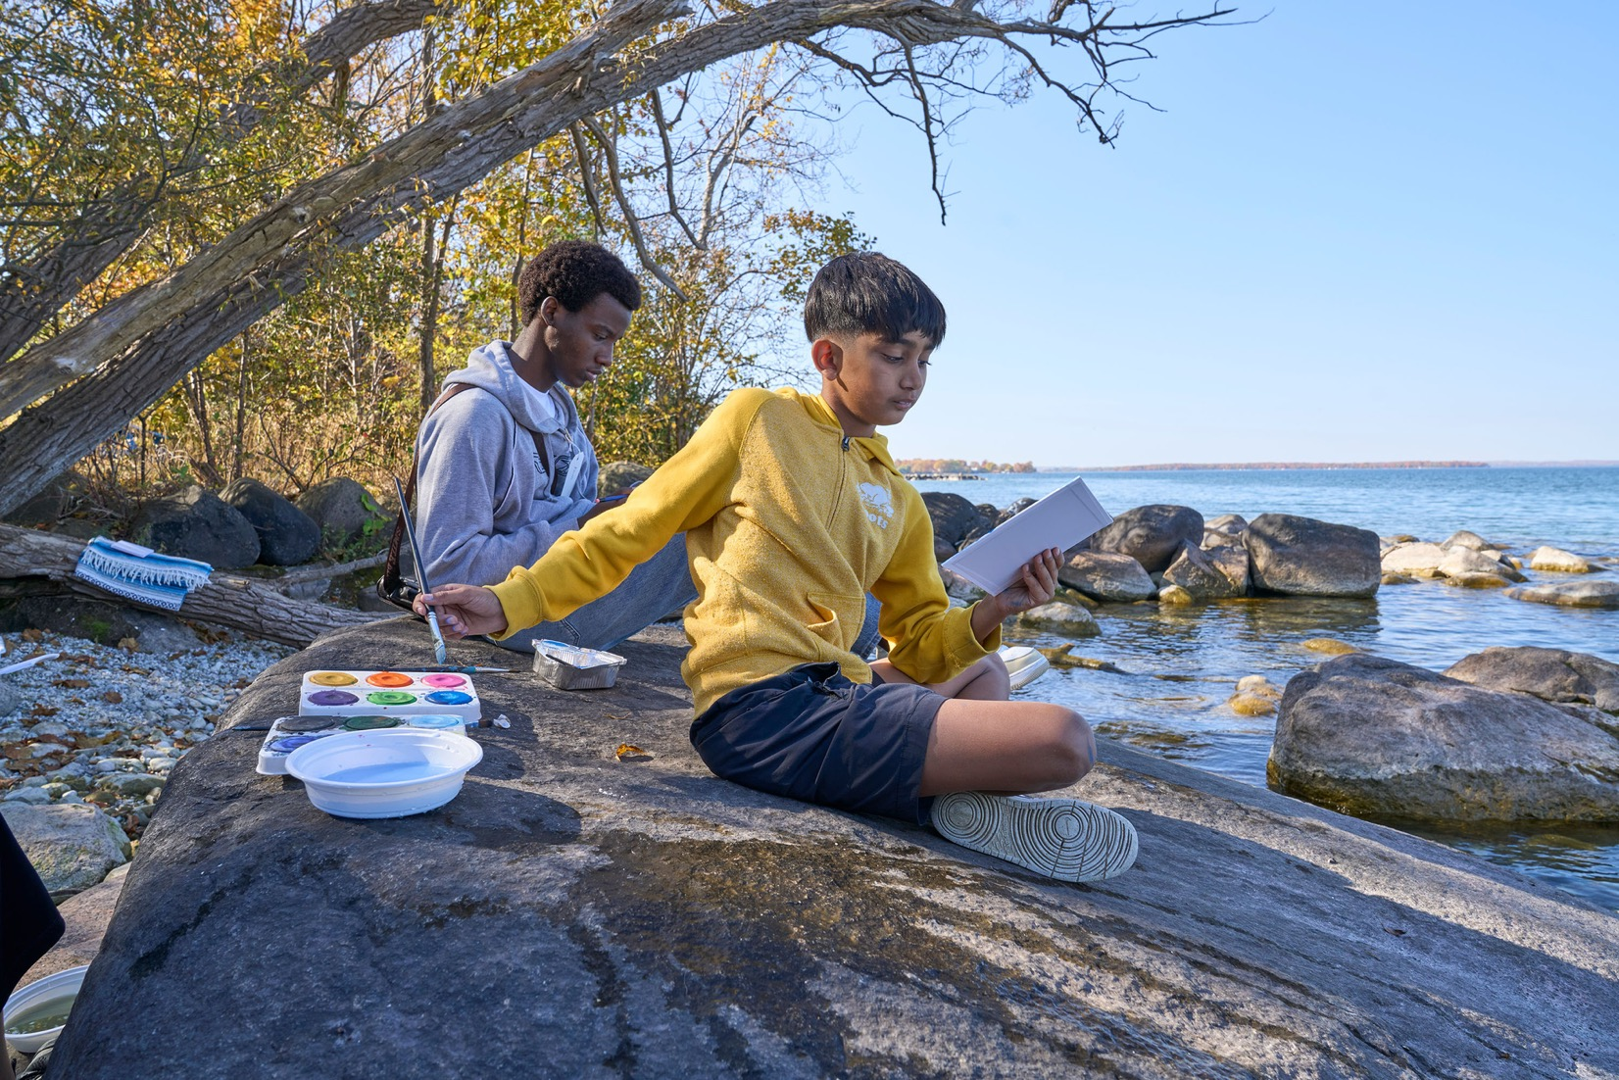
Sit spots are a great way to
CONNECT with nature and learn about animal superpowers.
Sketching, sound mapping and journaling are just a few sit-spot activities.
Find more at:
https://futurechicken.com/learning-resources/sit-spot-activities-for-kids/

Slide 20
What superpower am I most proud of?
CLUE: It’s NOT that I’m a superpooper!
I’m a PLANET PROTECTOR!
You can be a PLANET PROTECTOR too!

Slide 21
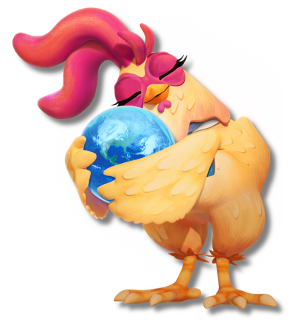
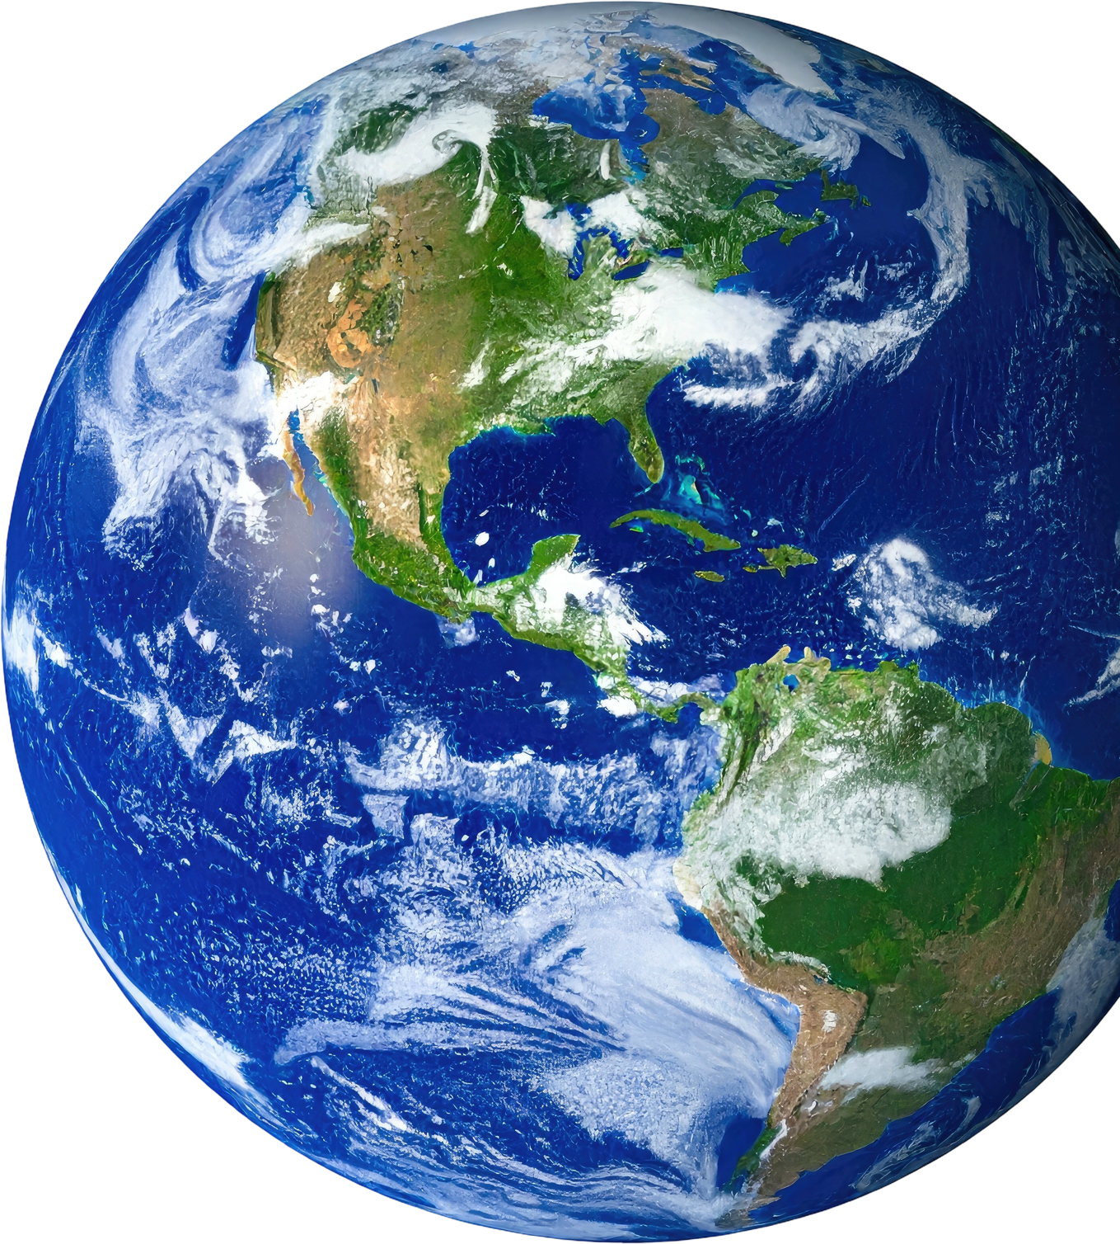
A PLANET PROTECTOR IS SOMEONE
WHO MIGHT?
Do you know any
Lead you on a guided hike
PLANET PROTECTORS?
Show you wild rescue animals
Help you take part in a local planting project
Help you plant trees or pollinator gardens at school
How could YOU be a
Help you build nesting boxes or bat boxes
PLANET PROTECTOR?
Help you restore places where animals live

Slide 22

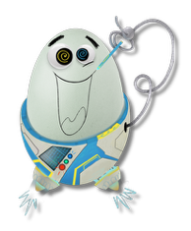
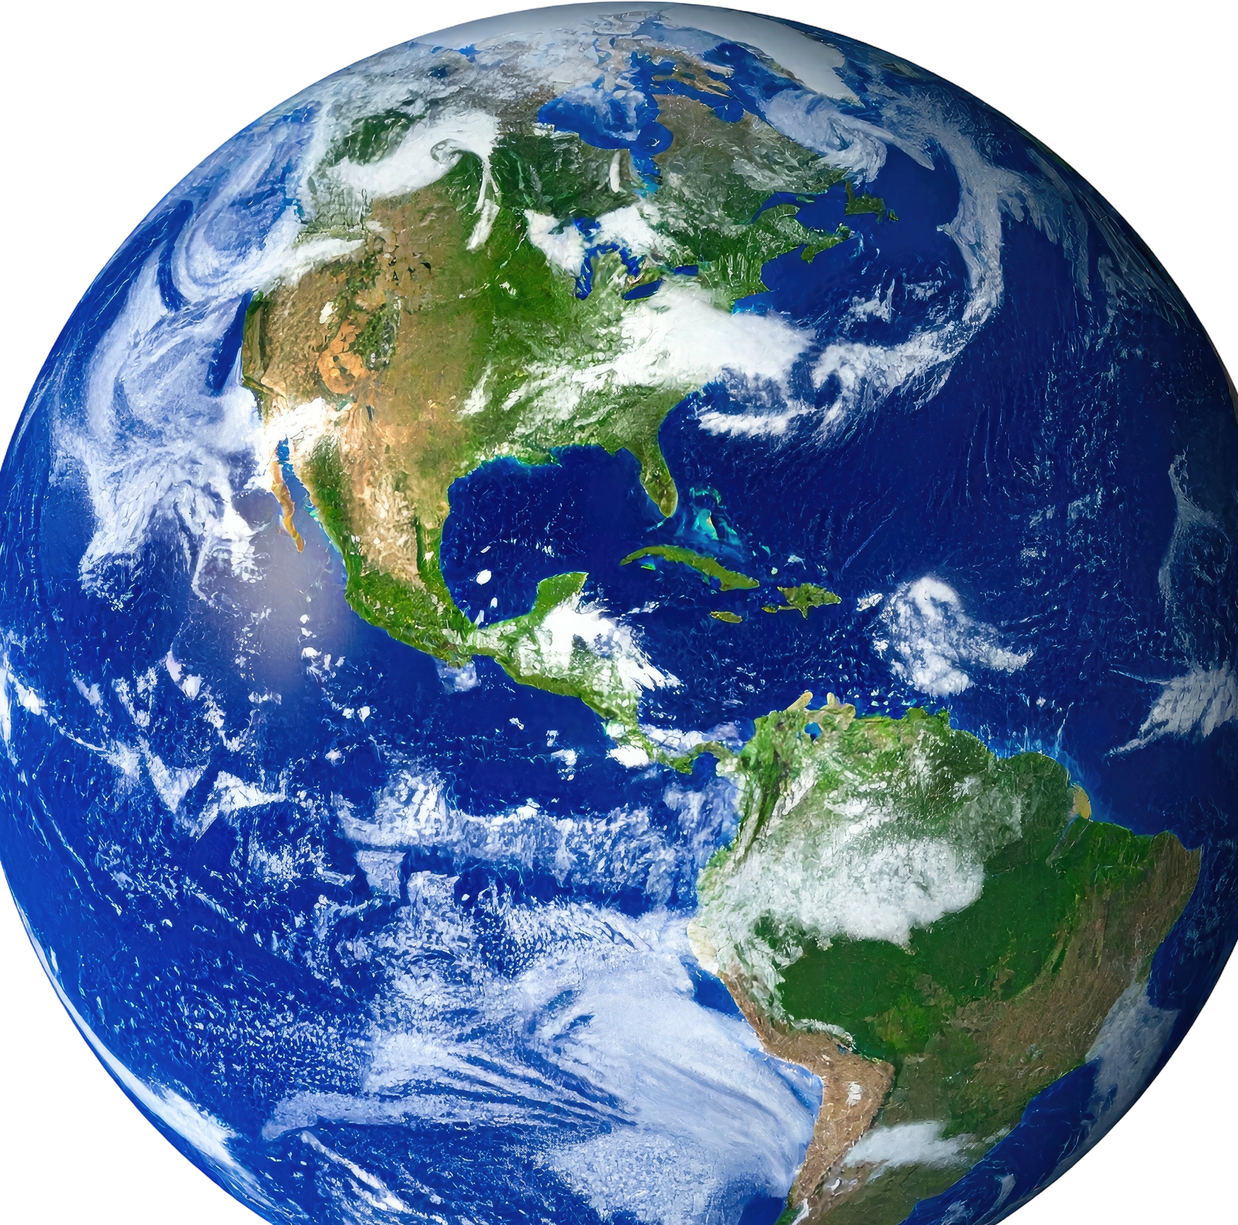
Nearby “Planet Protectors” Who Can Help Us
CONNECT with & PROTECT Habitats
and the Animals that Live in Them
Friends of the (look for the name of a local forest, wetland, lake, park, etc.) | Conservation Authorities | Organizations that Help People Plant Native Trees/Plants | Local Field Naturalist Organizations | Others | Local Wildlife Rehabilitation Centres

Slide 23
What is your
Superpower?
  Brainstorm some superpowers of people you admire. They can be famous people and people you know.
Examples of Superpowers
-making people laugh
-making people feel better
-drawing; tying knots
-solving math problems
-looking after pets
-noticing interesting things
-reading tricky words
  What is your superpower?
  Show examples
  Put the names of every student in your class into a bag. Without looking, each student pulls one name out of the bag. Each student identifies the superpower of the person whose name they pull. Alternatively, pair the students and have them identify each other’s superpower.
  Great read-aloud: https://inhabitmedia.com/2018/10/15/whats-my-superpower-is-a-blue-spruce-award-nominee/

Slide 24

Free, Easy-to-Set-Up Animal Adapations Activities Links
Beak Buffet: By using different “beak tools” (e.g. tongs, tweezers, medicine dropper, etc.) to pick up a variety of foods, students discover how beaks are adapted to the diets of particular birds.
Website: Little Bins for Little Hands
Bird Beak Worksheets: Free, downloadable and geared to various levels. Website: clipart-library.com/bird-beaks-worksheet.html
Animal Adaptations Fashion Show: Free lesson plans, worksheets and assessment tools: Animal Adaptations Fashion Show

Slide 25

Check out these Future Chicken Shorts on related topics! (1-3 minutes)
Animal Adaptations | Habitats | Connect & Protect
Butterfly Cycles Desert Beetles Dung Beetle Flying Foxes Giraffes Hippos Jumping Monkeys Kangaroo Ladybugs Lobsters Otters Polar Bears Salmon Run Spiders | Coral Reefs Florida Everglades Lakes Mangroves Swamps | Animal Bridges Baby Sea Turtles & Planet Celebrate Earth Month Community Clean Up Community Gardens Plant Trees Pollinator Highway Protectors Rooftop Gardens Bat Boxes Rain Barrels

